Slide 1

Art Contest
2024 - 2025

Slide 2

BEST IN SHOW
Hanika
Faith
De Garcia
William J. Clark Middle School
Orangeburg School District One
Teacher: Malissa Wright

Slide 3
Division 1
Grades K - 2

Slide 4

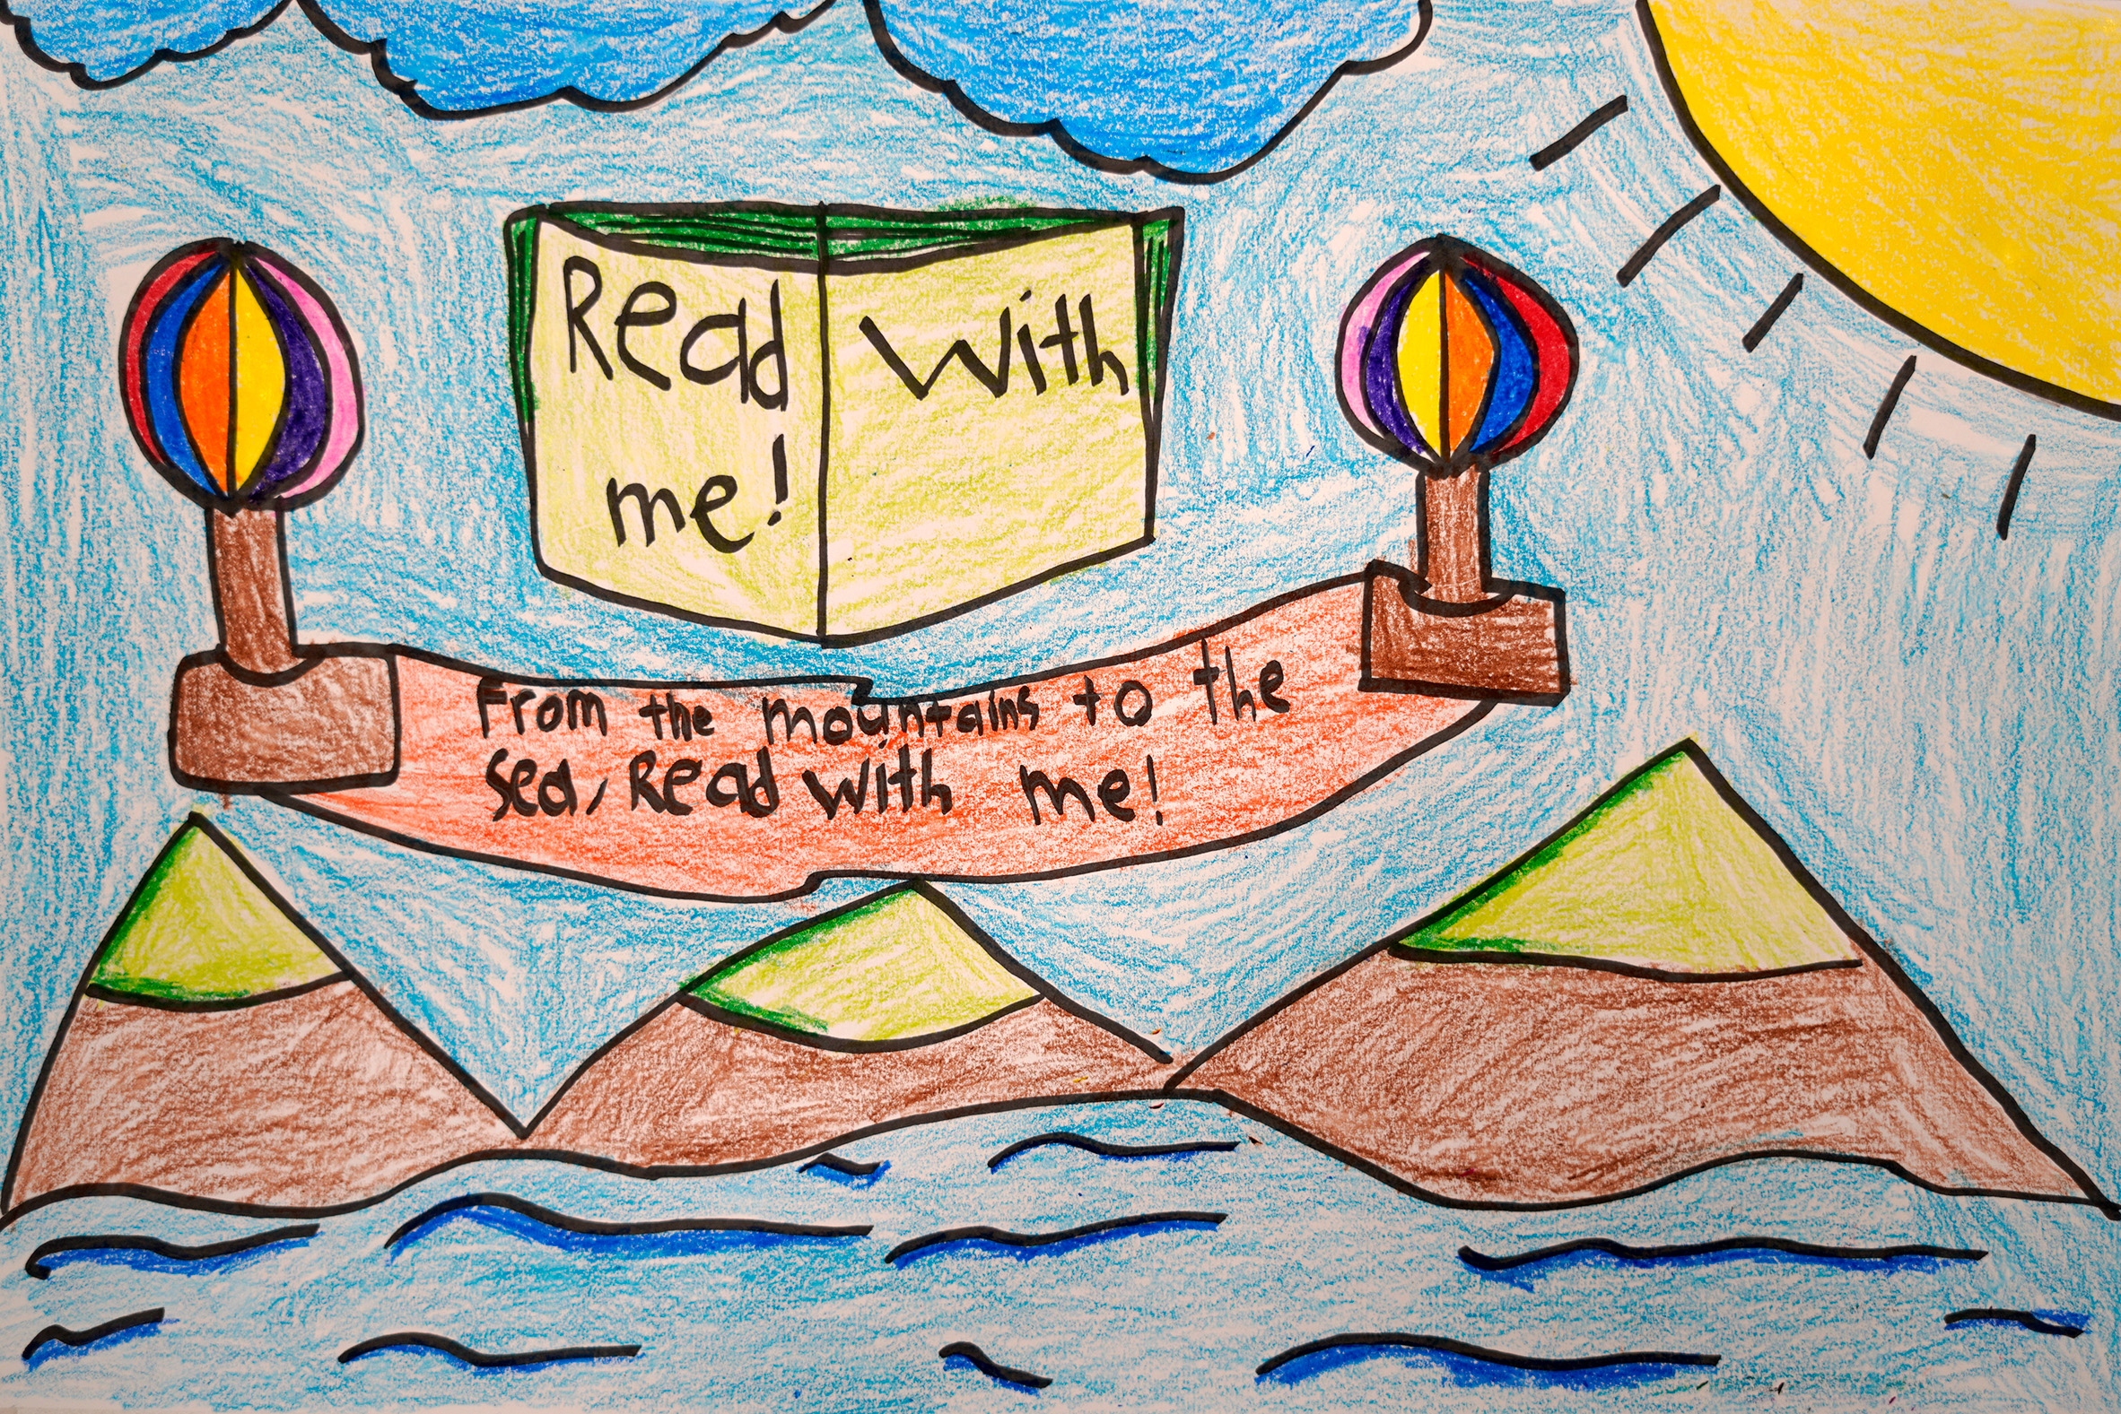
Honorable Mention
Margaux Alexis DeLeon
Division 1: K-2nd Grade
Carolina School for Inquiry
Richland County School District One
Teacher: Ms. T. Clarke

Slide 5
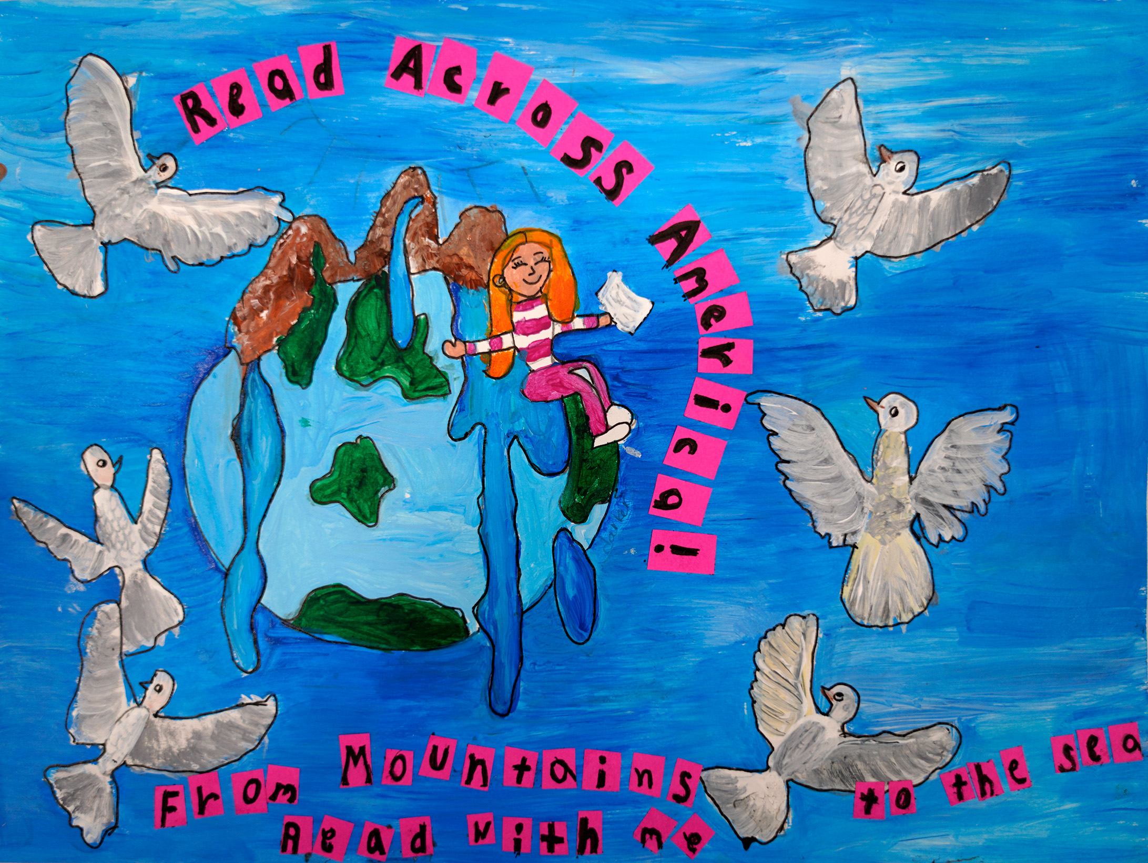
Honorable Mention
Elayna Robinson
Division 1: K-2nd Grade
Fairfield Magnet School For Math and Science
Fairfield County School District
Teacher: Kimi Daly

Slide 6
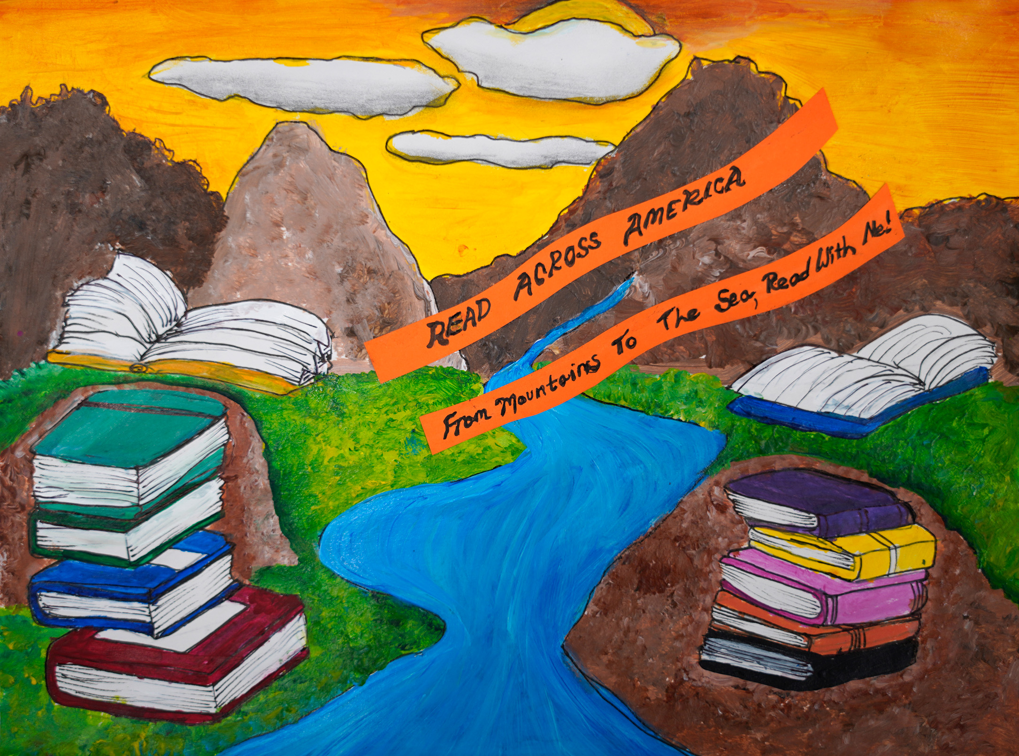
Honorable Mention
Reagan Shepard
Division 1: K-2nd Grade
Fairfield Magnet School For Math and Science
Fairfield County School District
Teacher: Kimi Daly

Slide 7
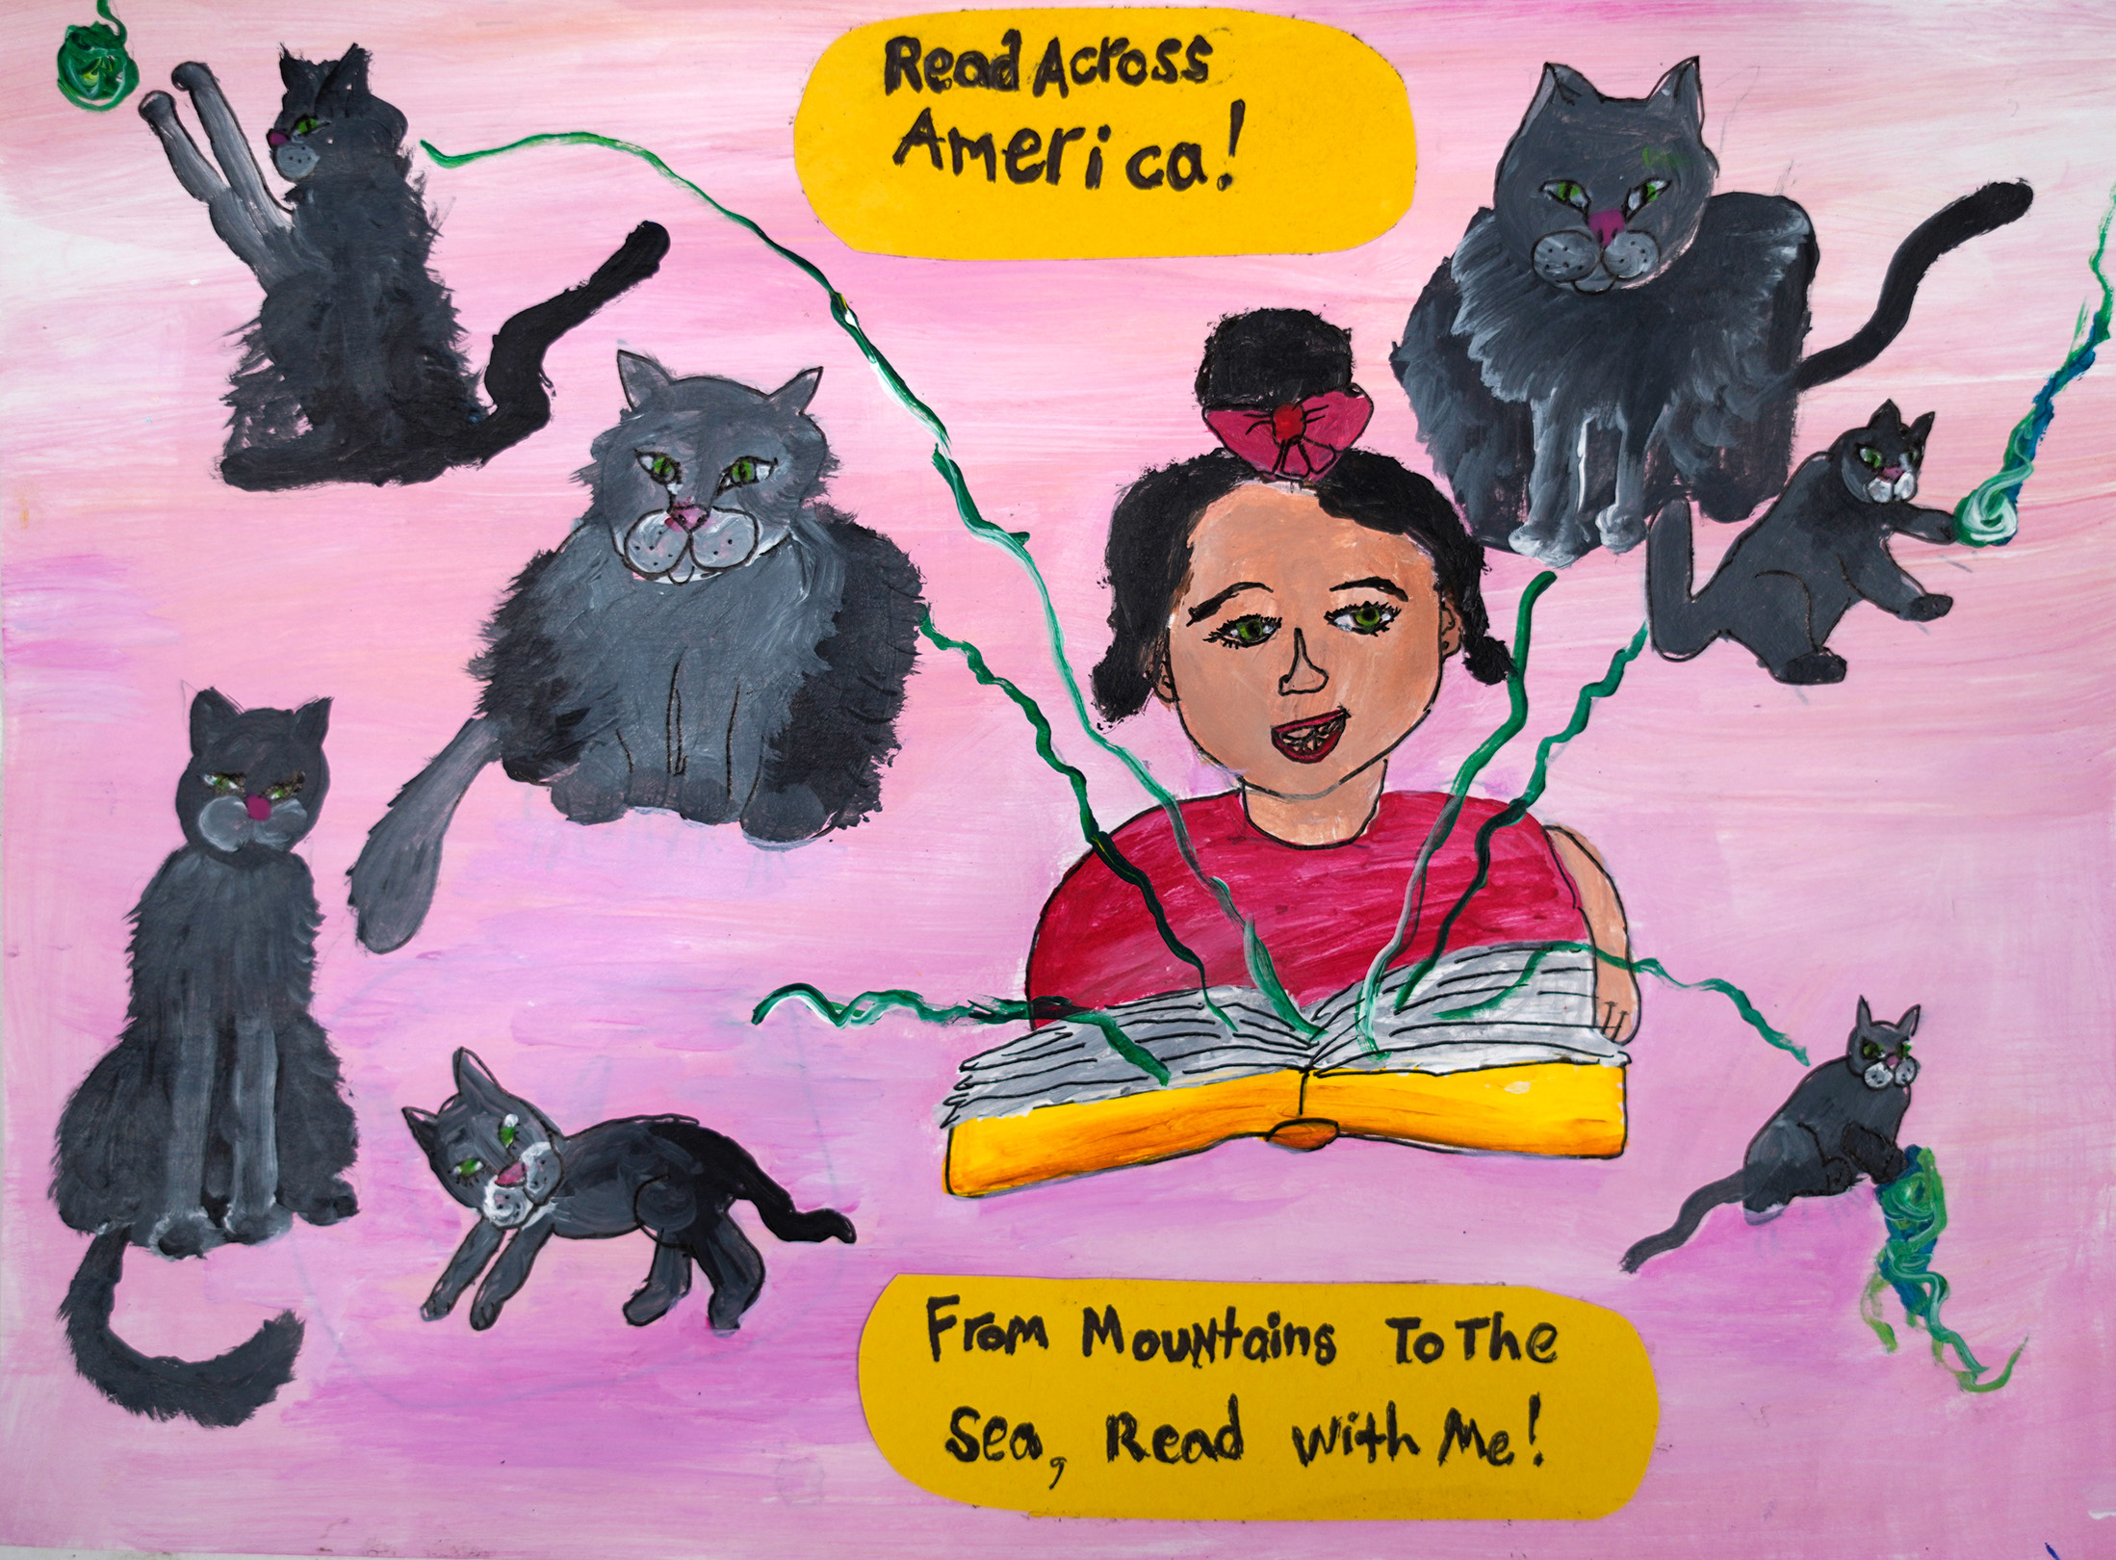
Honorable Mention
Aerrin McCullough
Division 1: K-2nd Grade
Fairfield Magnet School For Math and Science
Fairfield County School District
Teacher: Kimi Daly

Slide 8
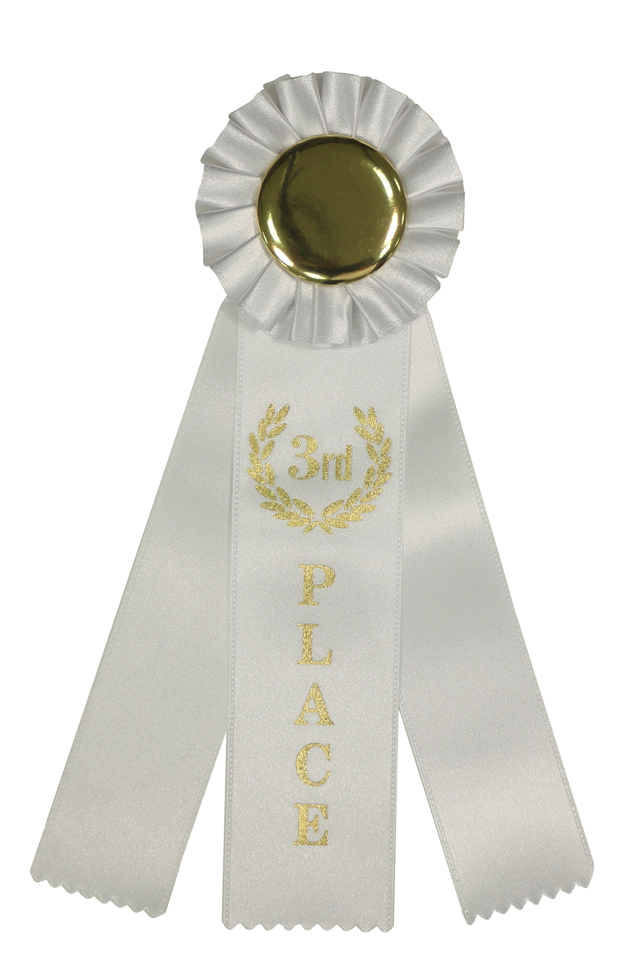
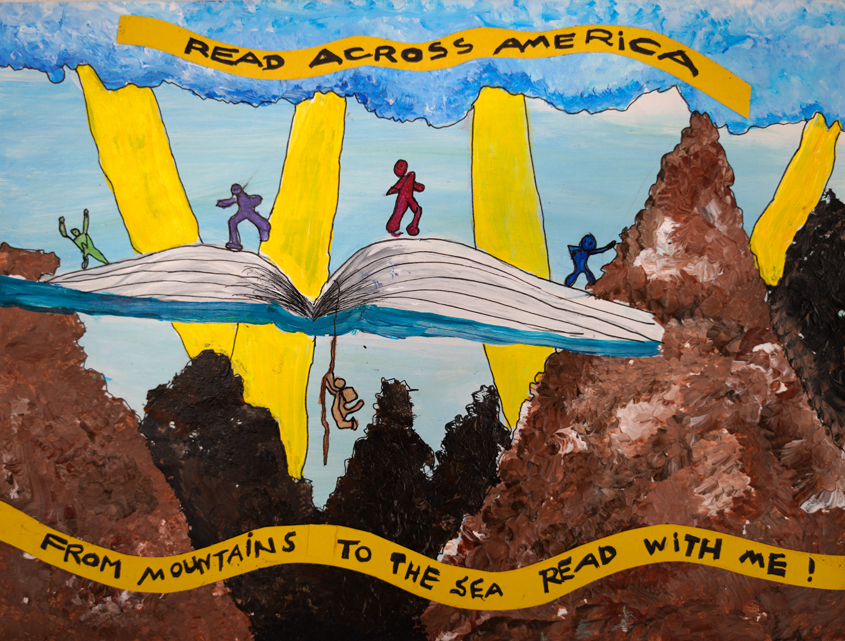
3rd Place Winner
Rhett Branham
Division 1: K – 2nd Grade
Fairfield Magnet School For Math and Science
Fairfield County School District
Teacher: Kimi Daly

Slide 9
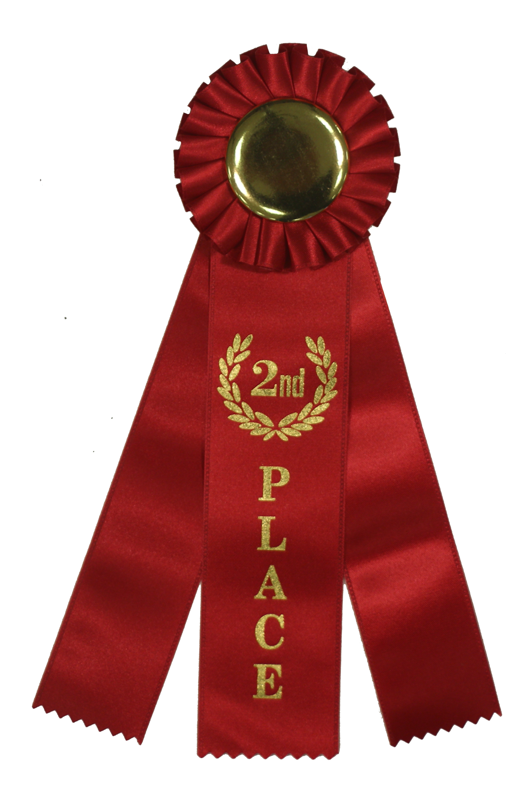
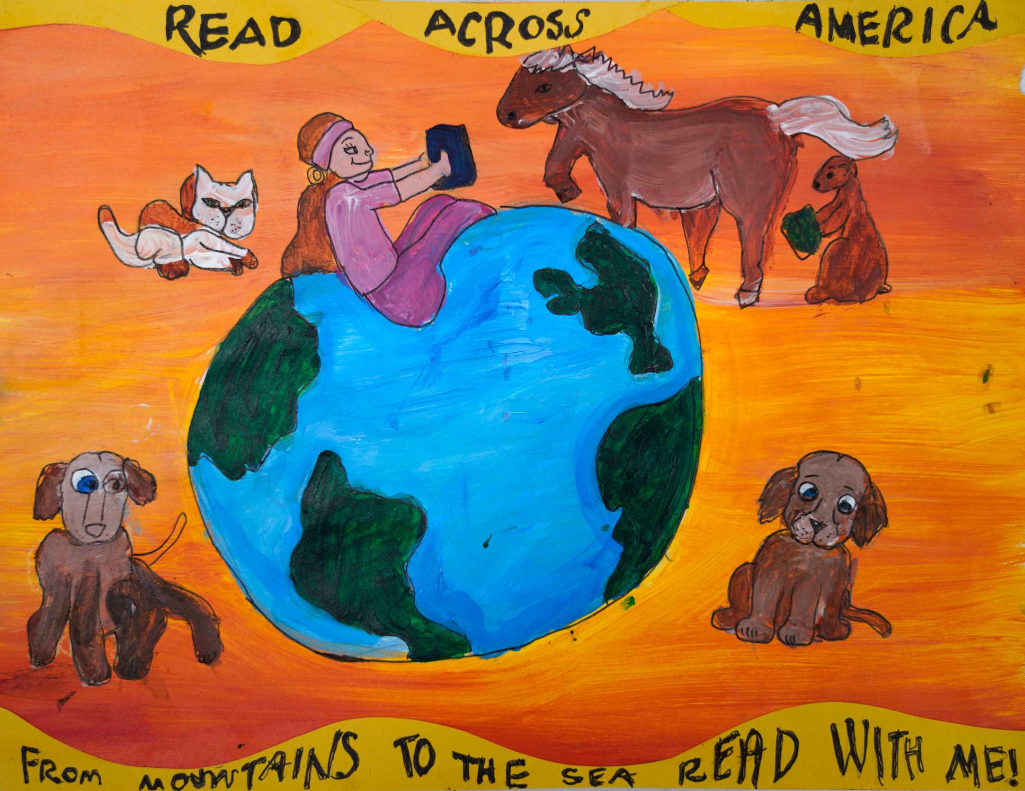
2nd Place Winner
Matilda Reid
Division 1: K-2nd Grade
Fairfield Magnet School For Math and Science
Fairfield County School District
Teacher: Kimi Daly

Slide 10
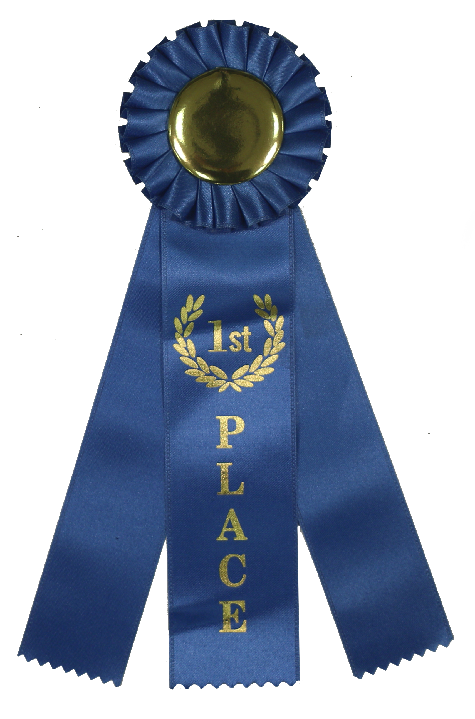
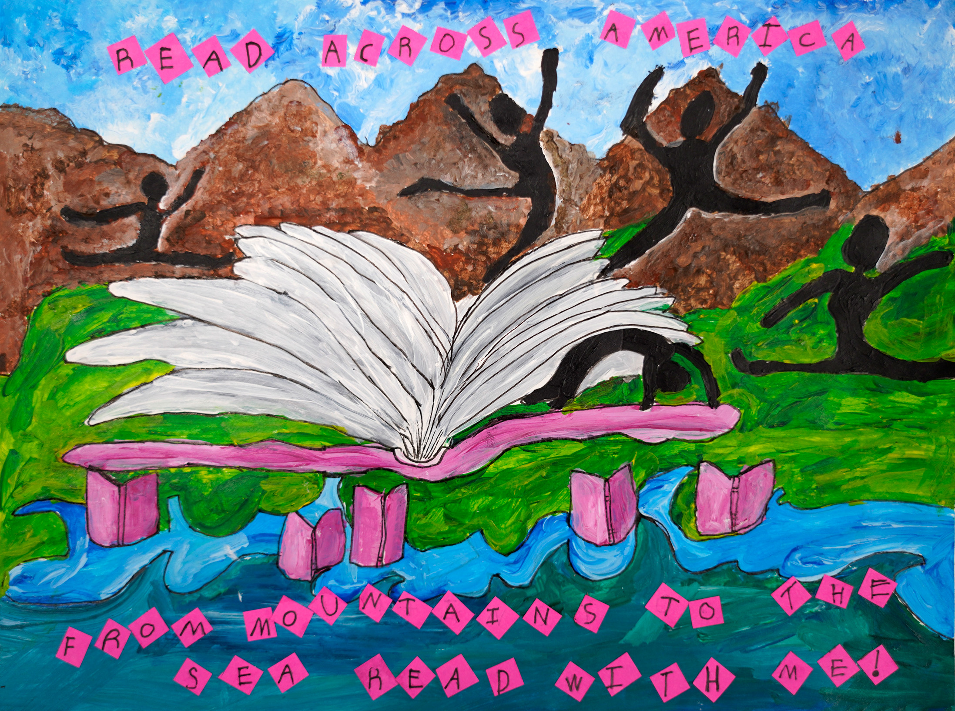
1St Place Winner
Raelyn Wilson
Division 1: K-2nd Grade
Fairfield Magnet School For Math and Science
Fairfield County School District
Teacher: Kimi Daly

Slide 11
Division 2
Grades 3 - 5

Slide 12
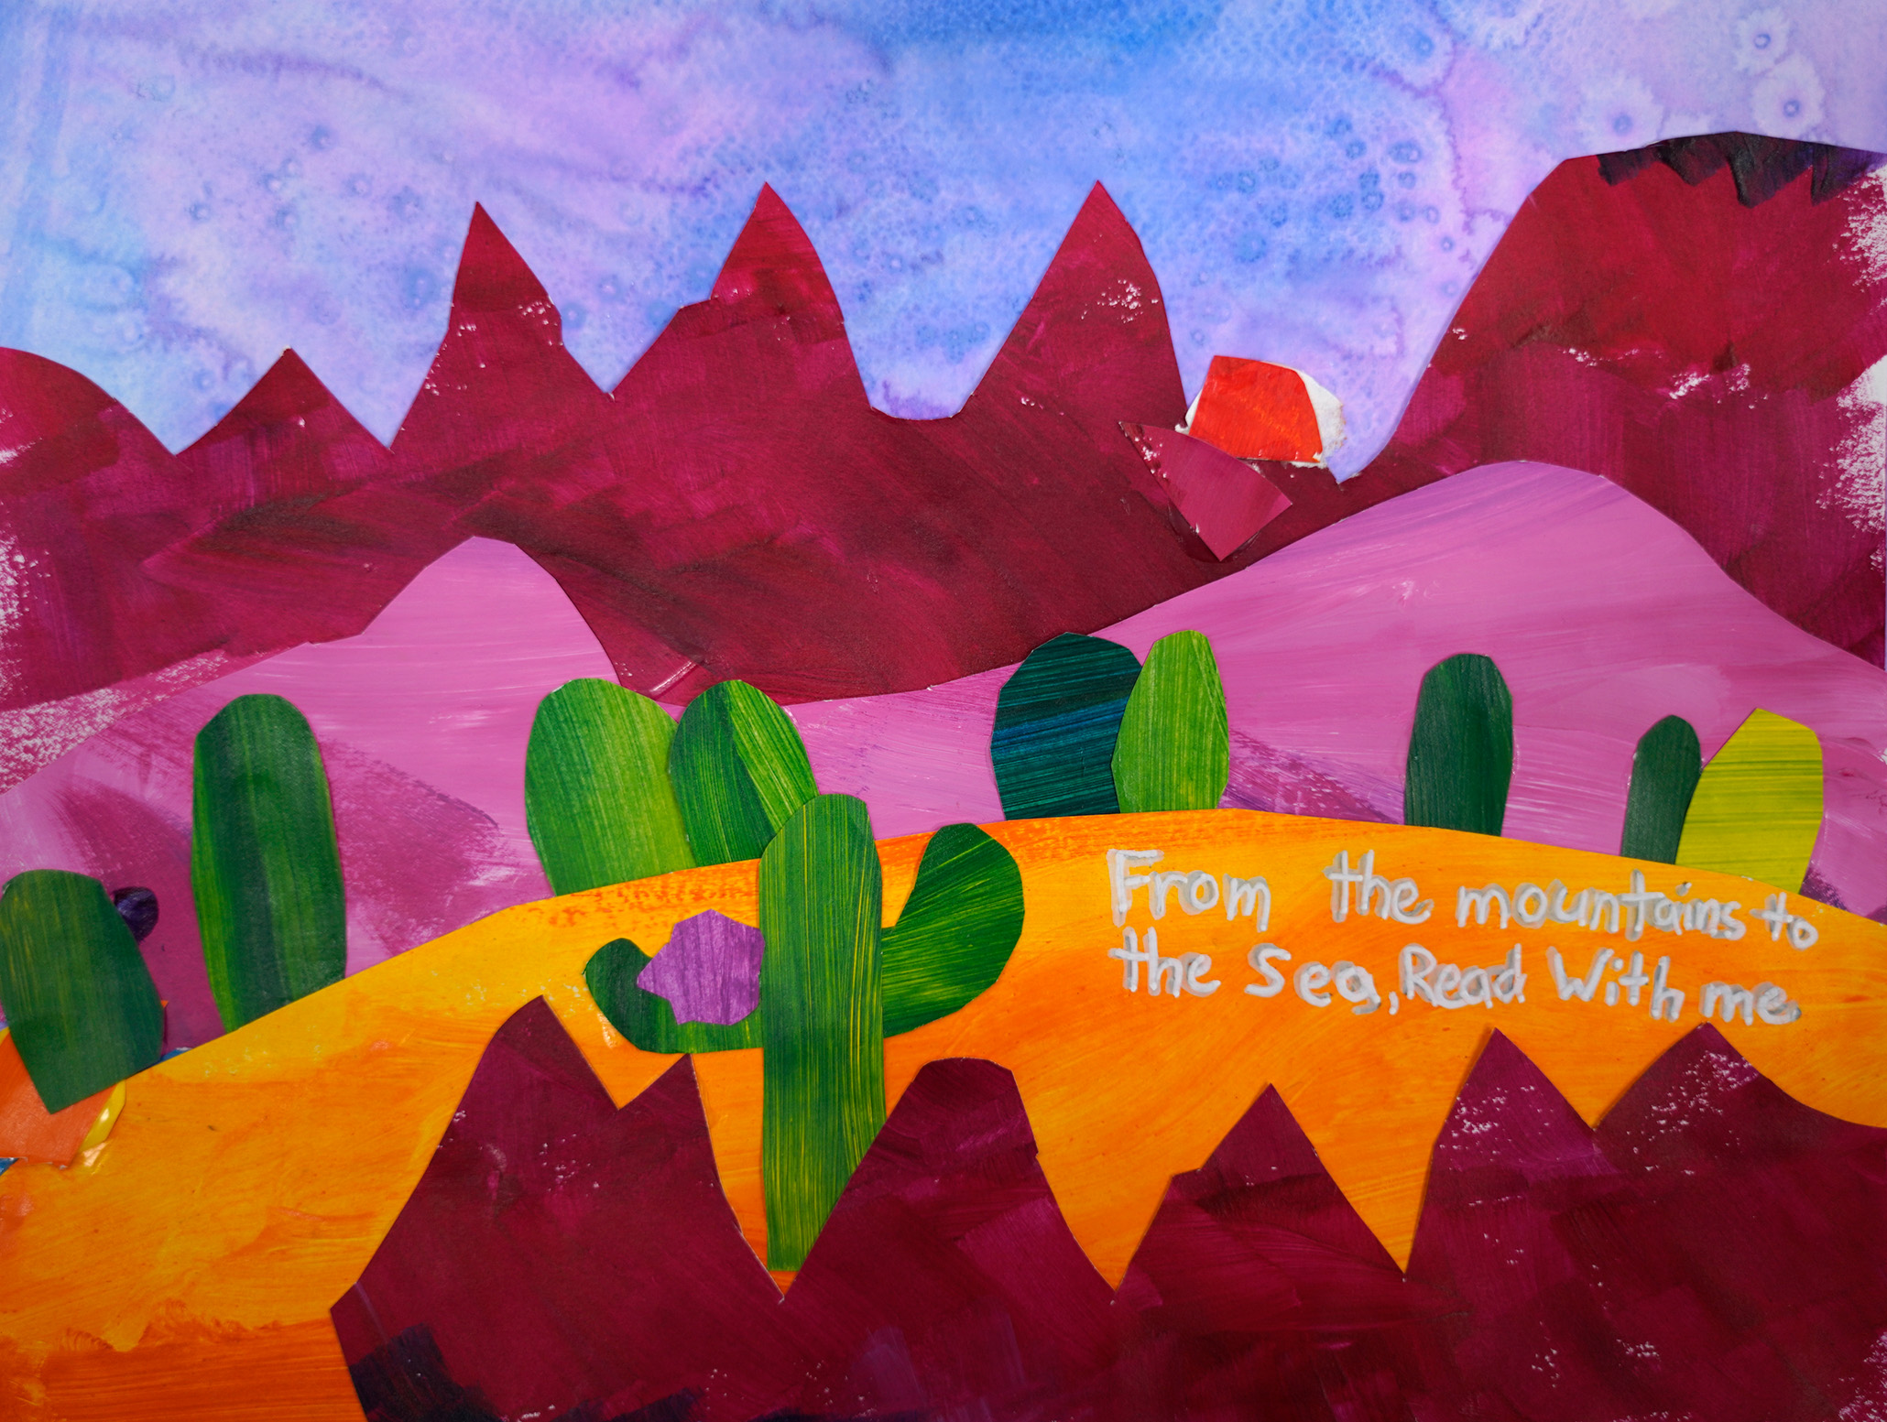
Honorable Mention
Virginia Reynolds
Division 2: 3 – 5th Grade
Camperdown Academy
Greenville County School District
Teacher: Ruth Thomas

Slide 13
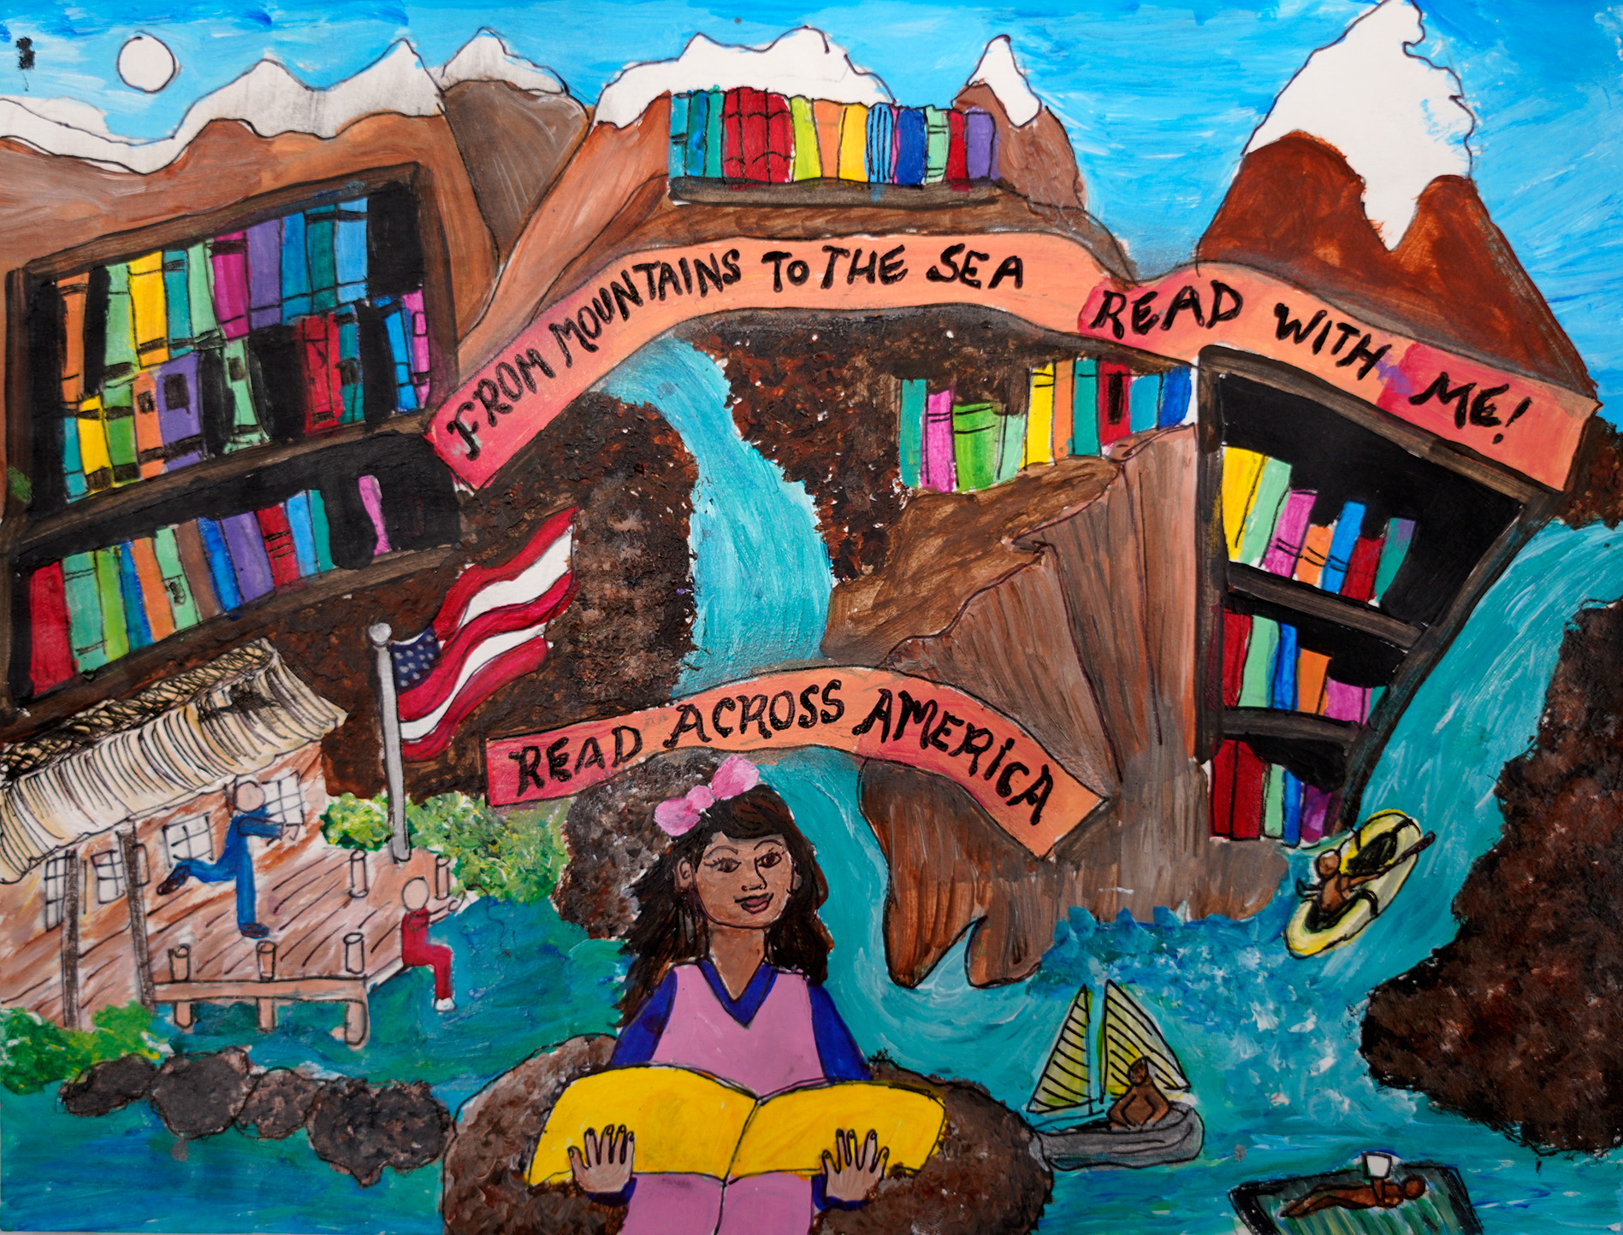
Honorable Mention
Mar’Zya Jeanty
Division 2: 3 – 5th Grade
Fairfield Magnet School
for Math & Science
Fairfield School District
Teacher: Kimi Daly

Slide 14
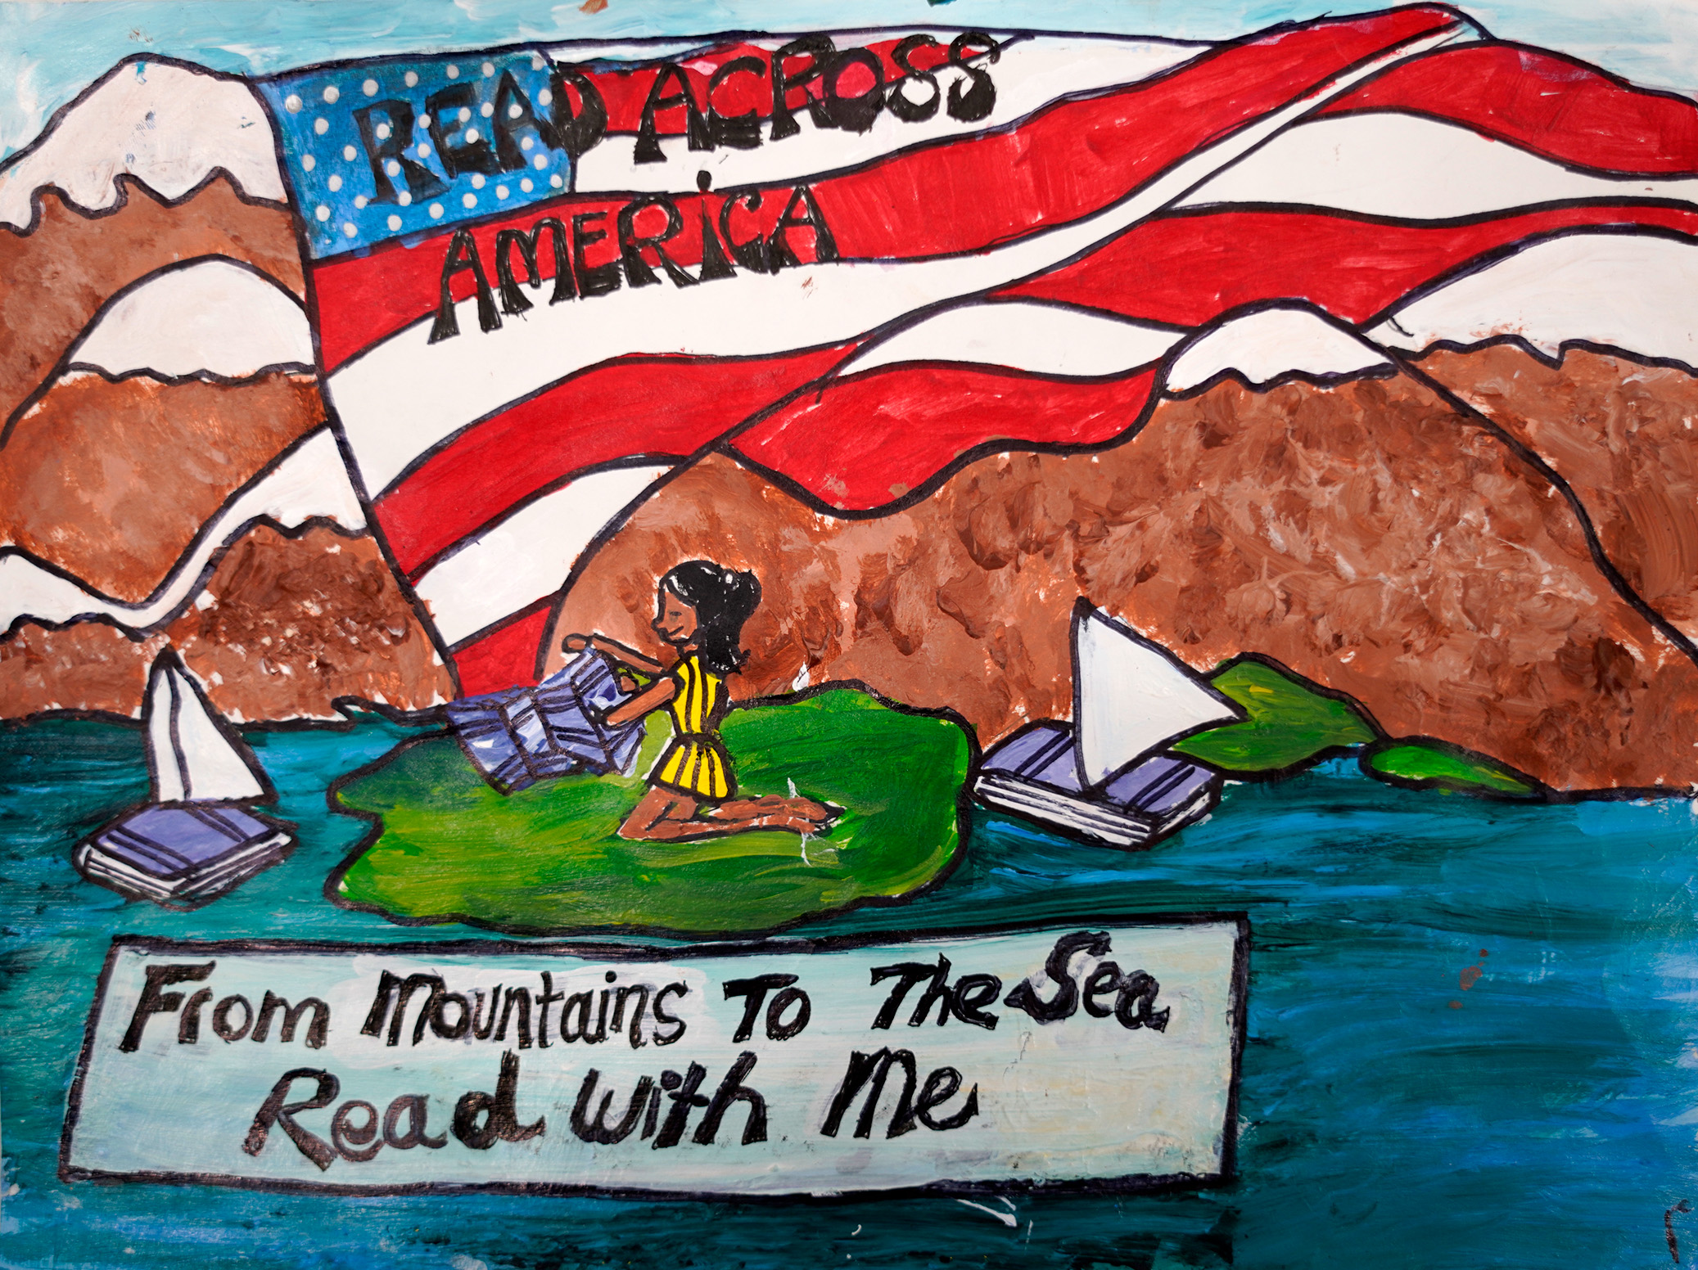
Honorable Mention
Skylar Boyd
Division 2: 3 – 5th Grade
Fairfield Magnet School
for Math & Science
Fairfield School District
Teacher: Kimi Daly

Slide 15
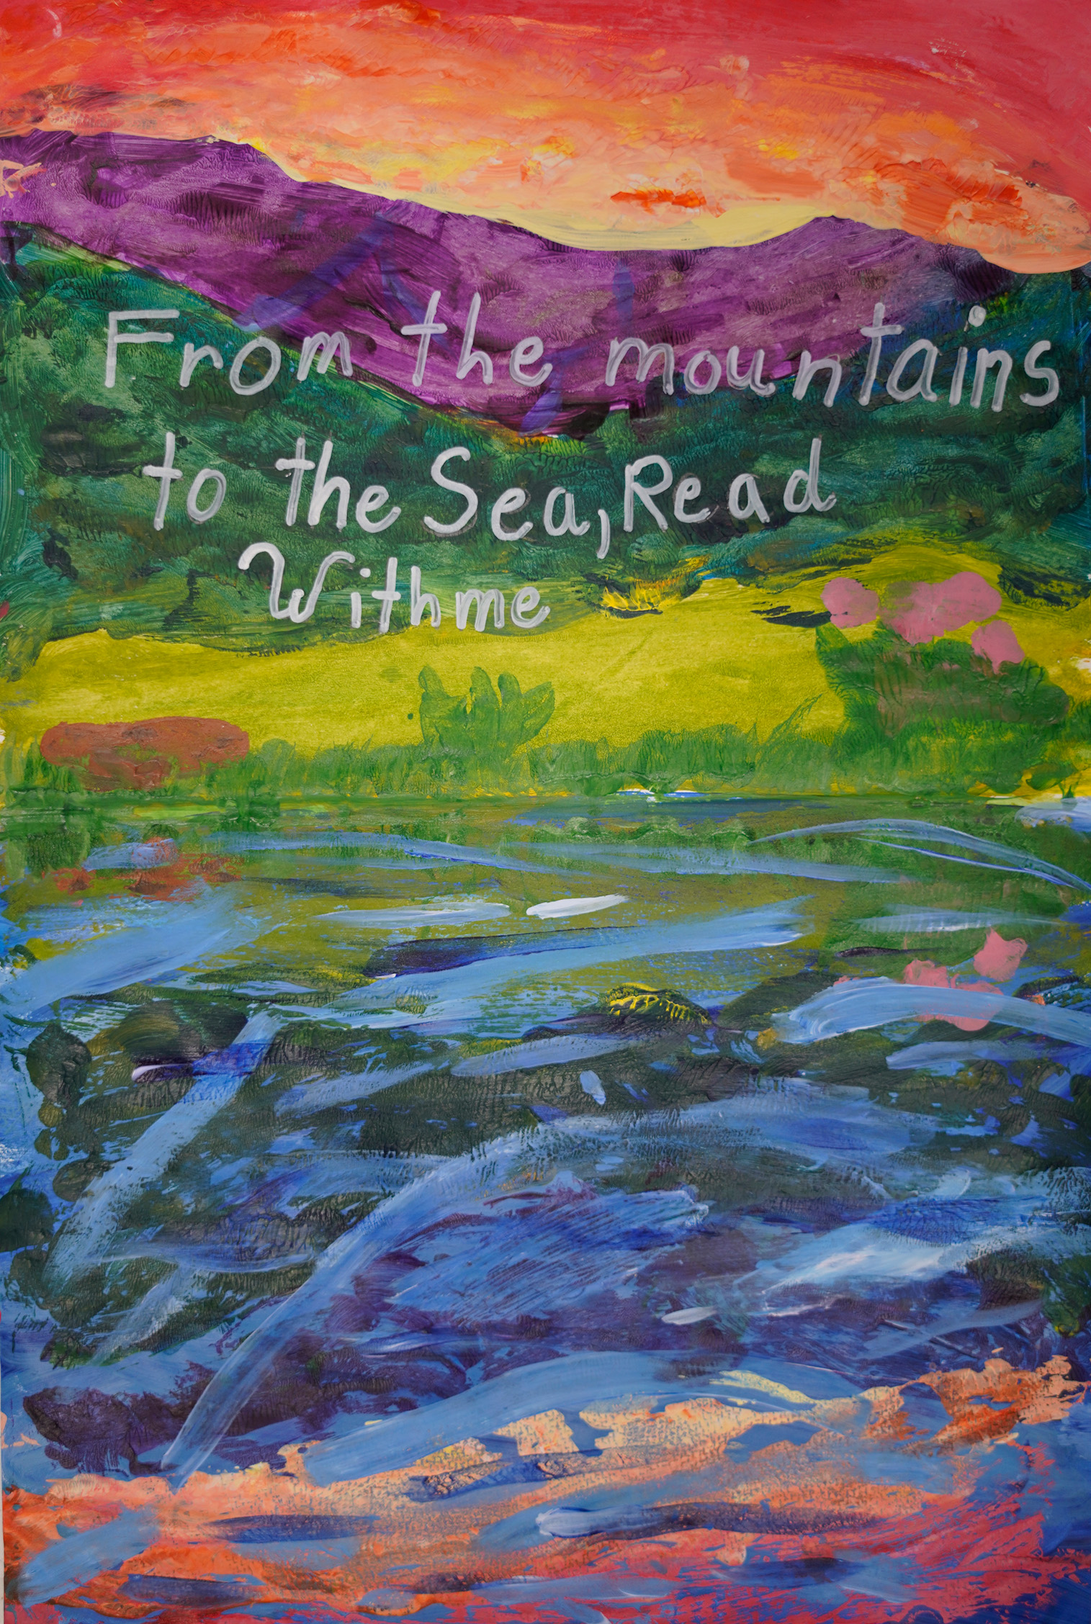
Honorable Mention
Marzelleigh-Ann Sill
Division 2: 3 – 5th Grade
Camperdown Academy
Greenville County School District
Teacher: Ruth Thomas

Slide 16
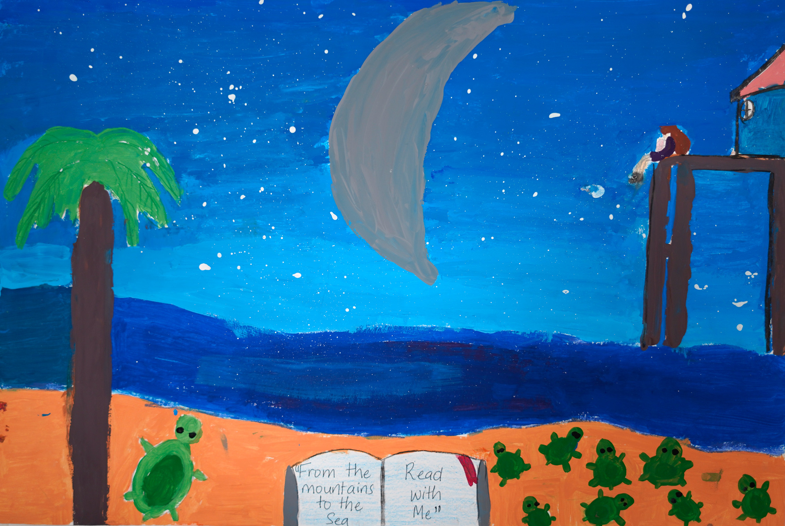
Honorable Mention
Jheyla Romero
Division 2: 3 – 5th Grade
Carolina School of Inquire
Richland County School District One
Teacher: Ms. T. Clarke

Slide 17
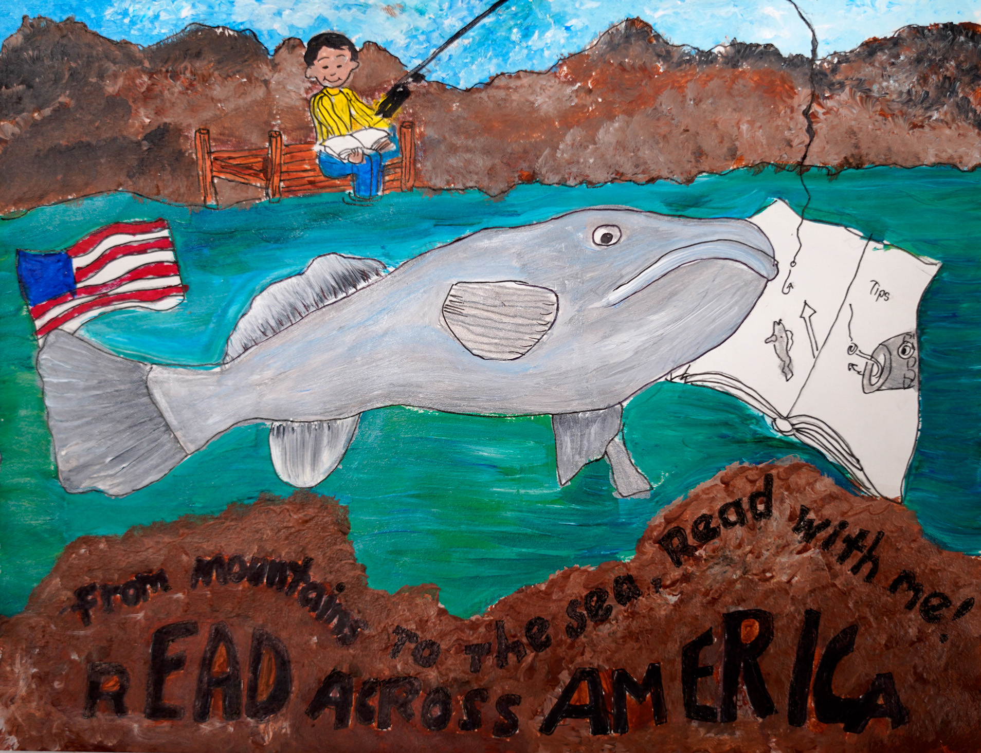
3rd Place Winner
Jhoel Warren
Division 2: 3 – 5th Grade
Fairfield Magnet School
for Math & Science
Fairfield School District
Teacher: Kimi Daly

Slide 18
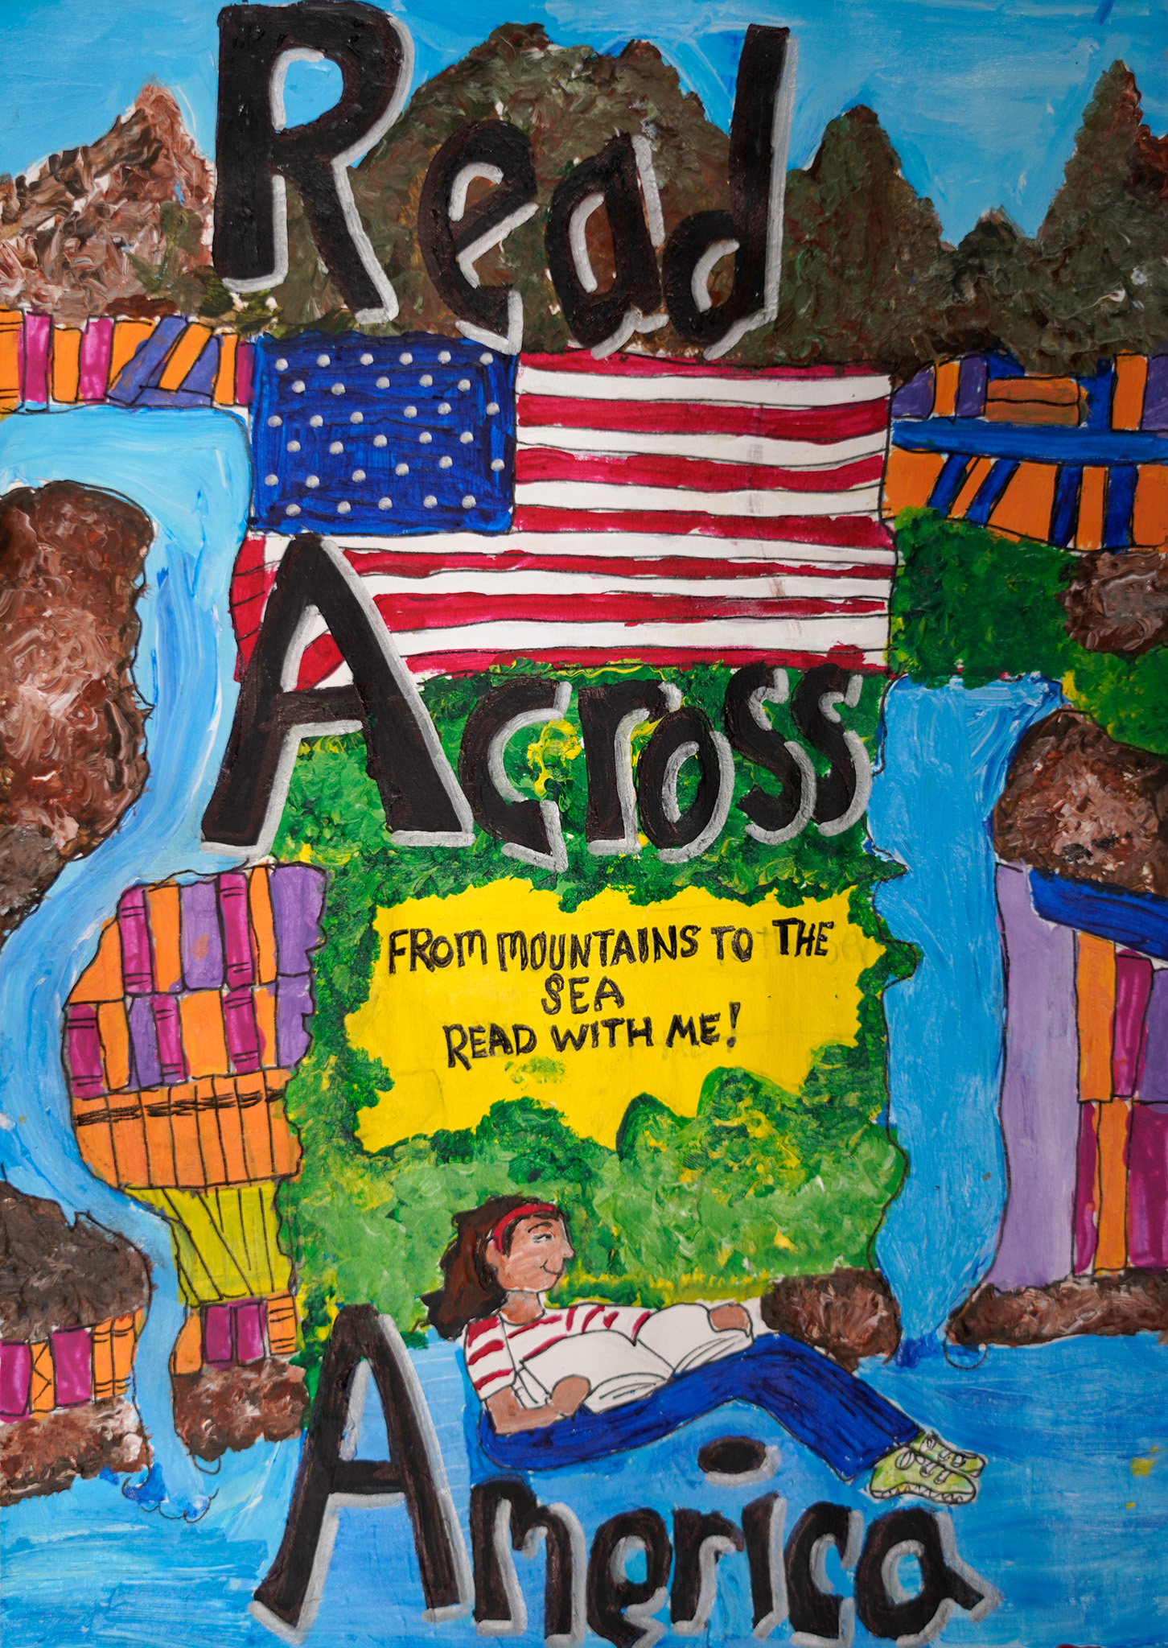
2nd Place Winner
Mariah Sanders
Division 2: 3 – 5th Grade
Fairfield Magnet School
for Math & Science
Fairfield School District
Teacher: Kimi Daly

Slide 19
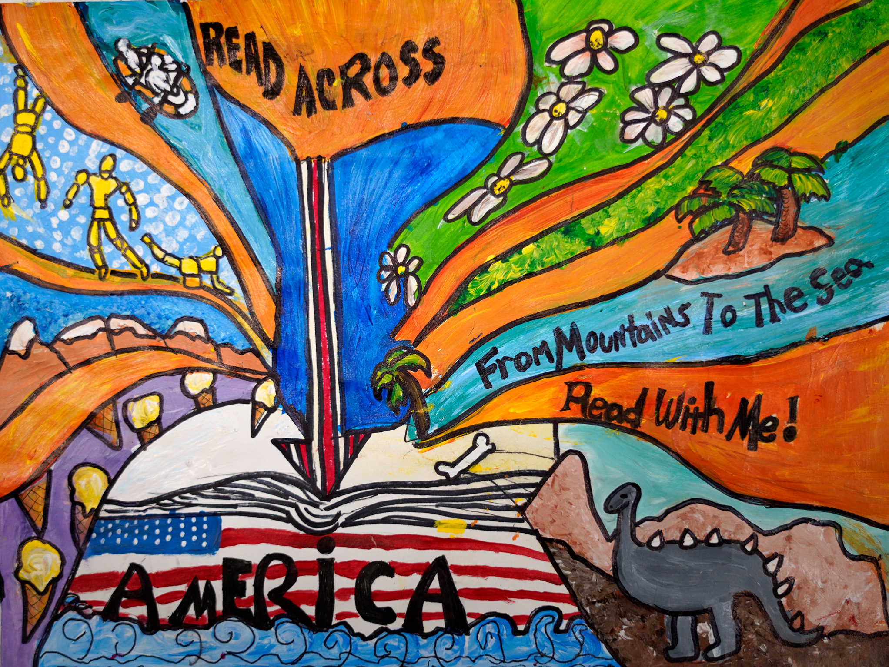
1st Place Winner
Mariana Torres
Division 2: 3 – 5th Grade
Fairfield Magnet School
for Math & Science
Fairfield School District
Teacher: Kimi Daly

Slide 20
Division 3
Grades 6 - 8

Slide 21
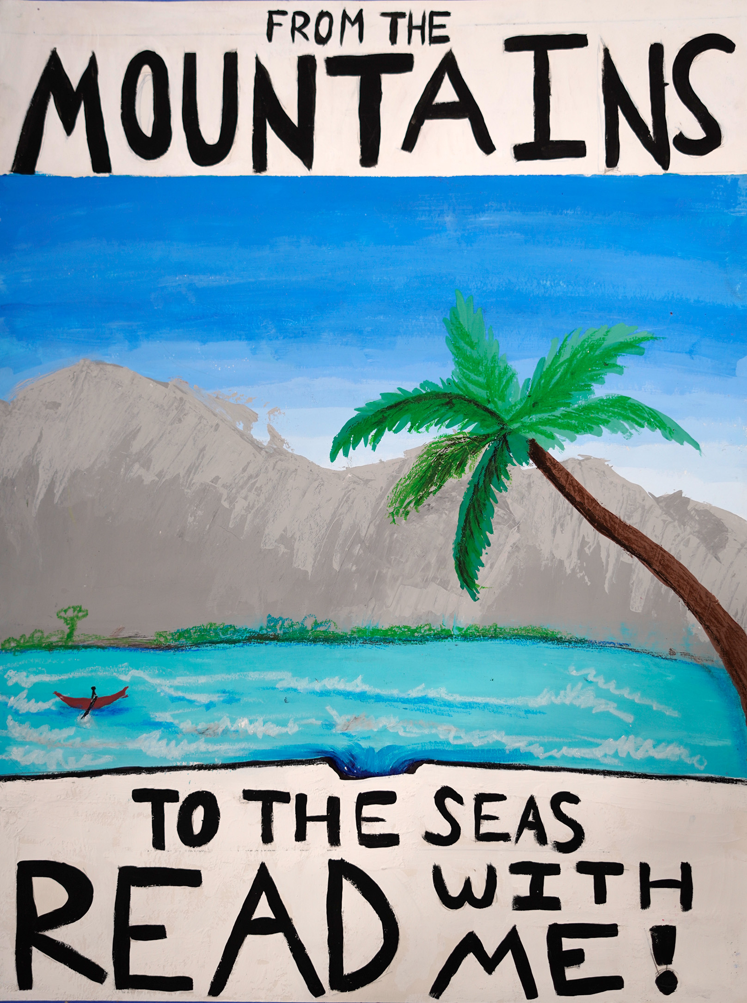
Honorable Mention
Katherine Driggers
Division 3: 6 – 8th Grade
Hopkins Middle School
Richland County
School District One
Teacher: Yaw Abbrey

Slide 22
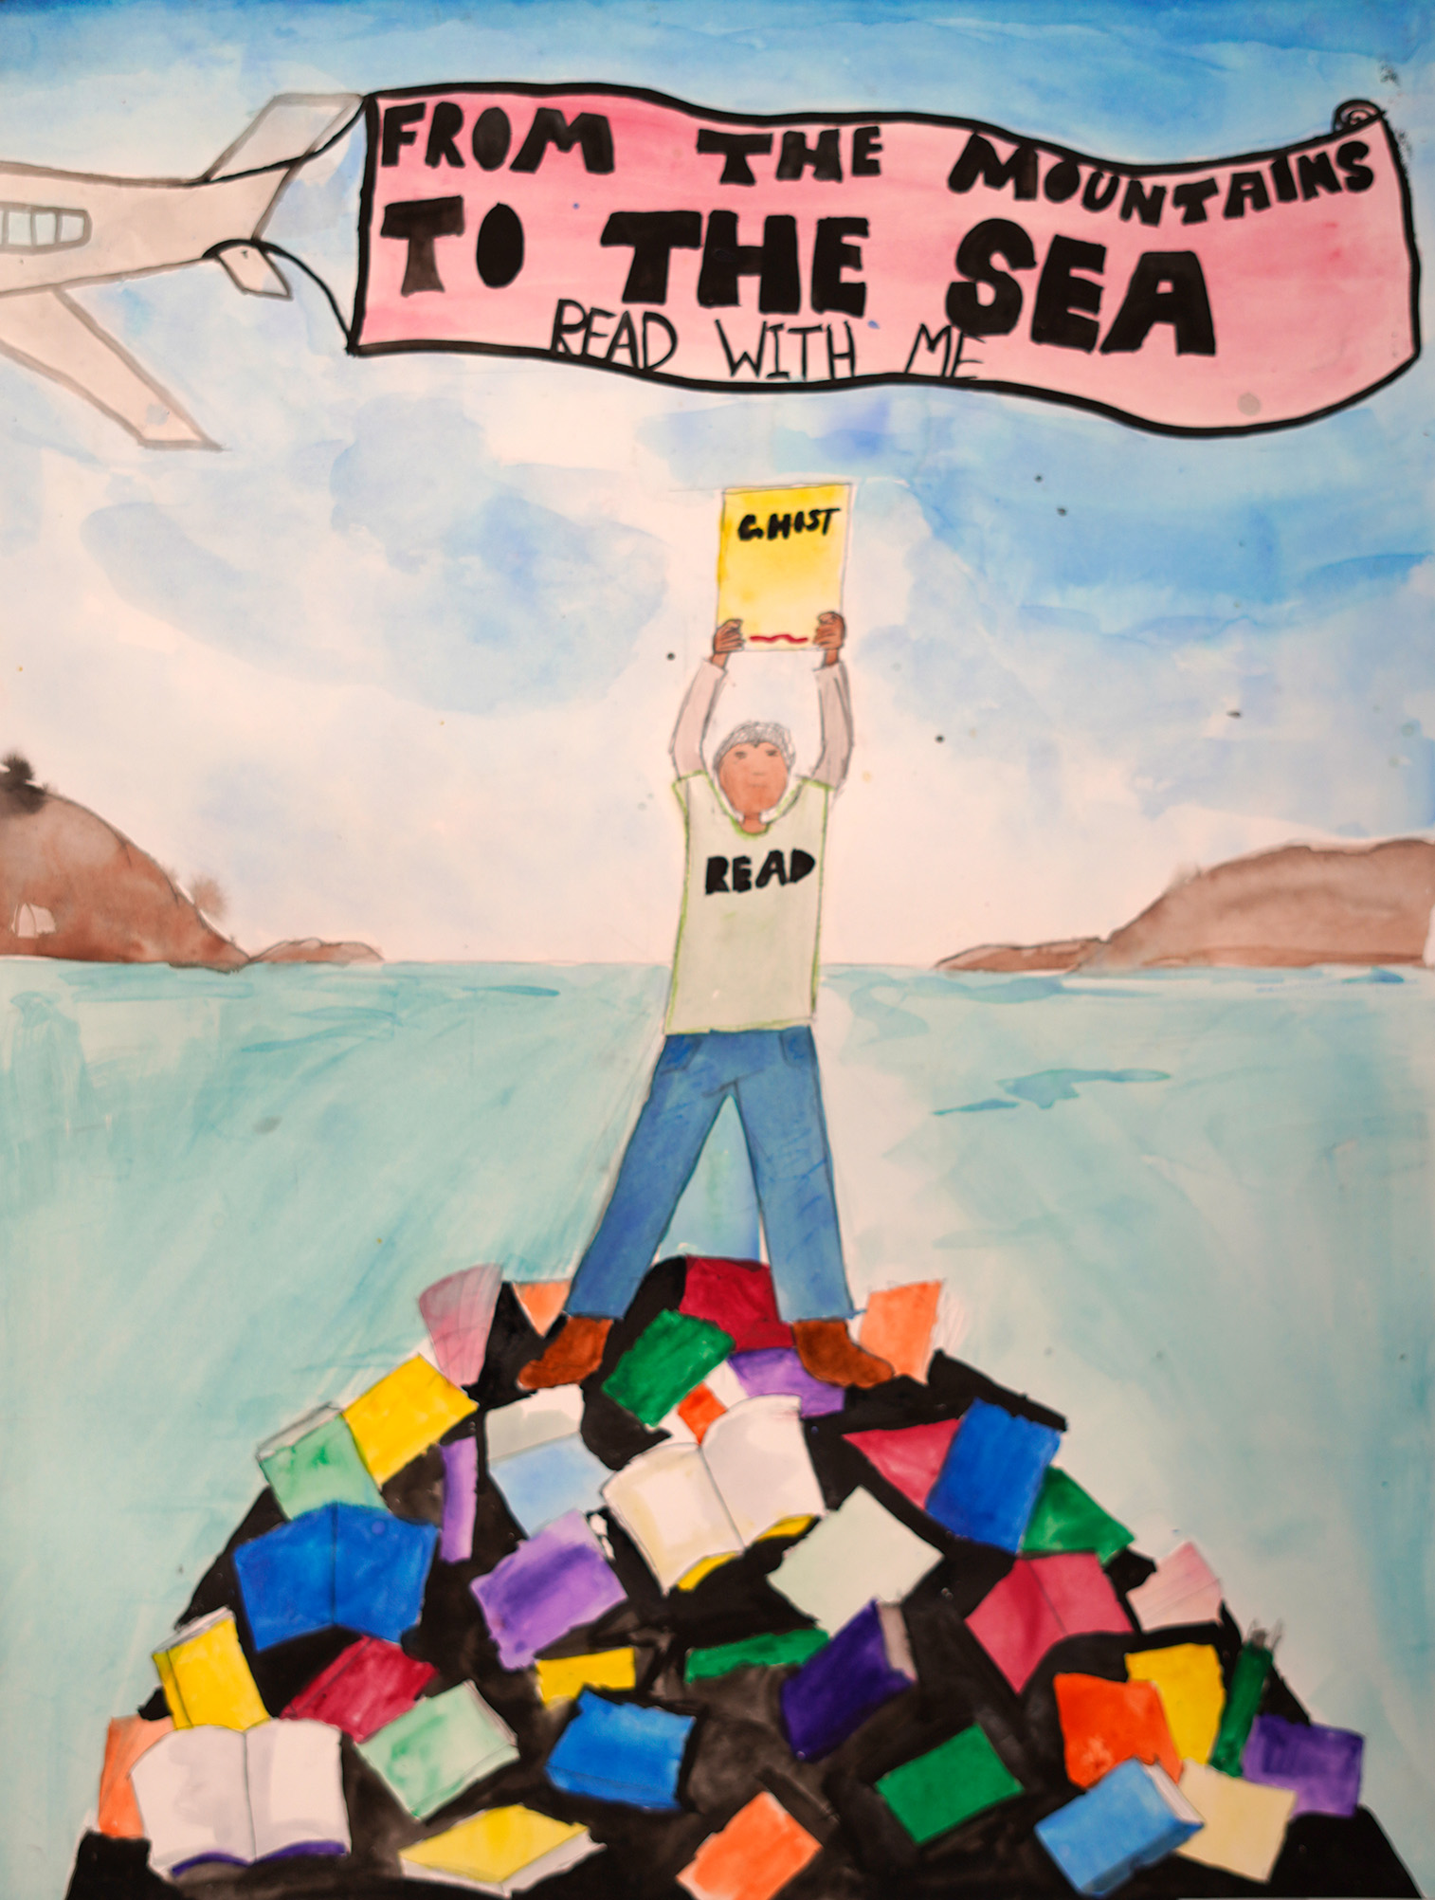
Honorable Mention
Brianna Brown
Division 3: 6 – 8th Grade
Hopkins Middle School
Richland County
School District One
Teacher: Yaw Abbrey

Slide 23
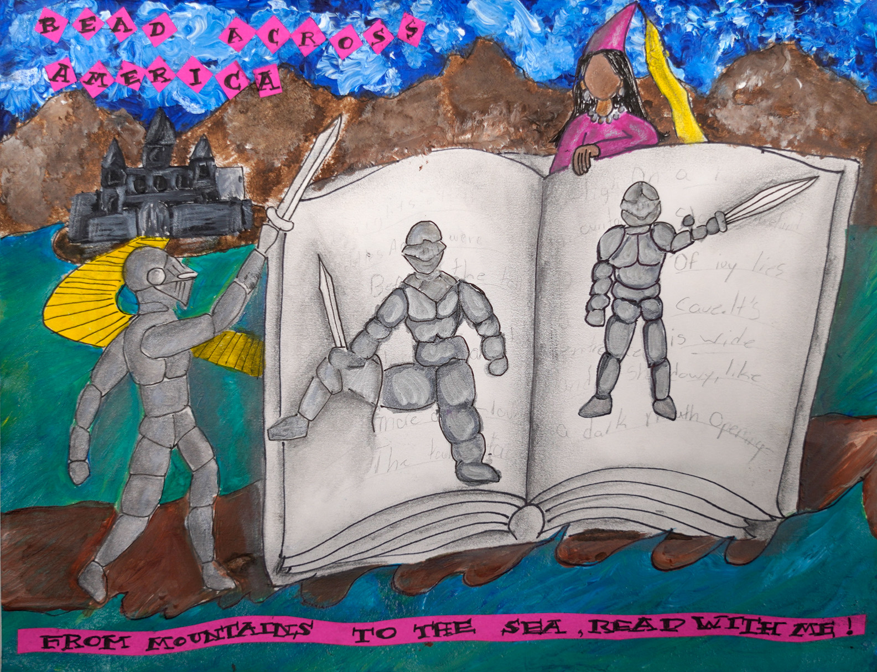
Honorable Mention
Alianna Smith
Division 3: 6 – 8th Grade
Fairfield Magnet School
for Math & Science
Fairfield School District
Teacher: Kimi Daly

Slide 24
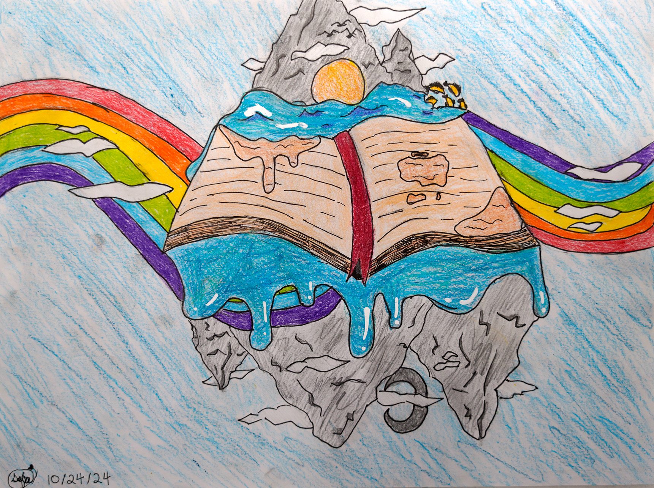
Honorable Mention
Sofia Michalski
Division 3: 6 – 8th Grade
Ten Oaks Middle School
Horry County School District
Teacher: Patrick Best

Slide 25
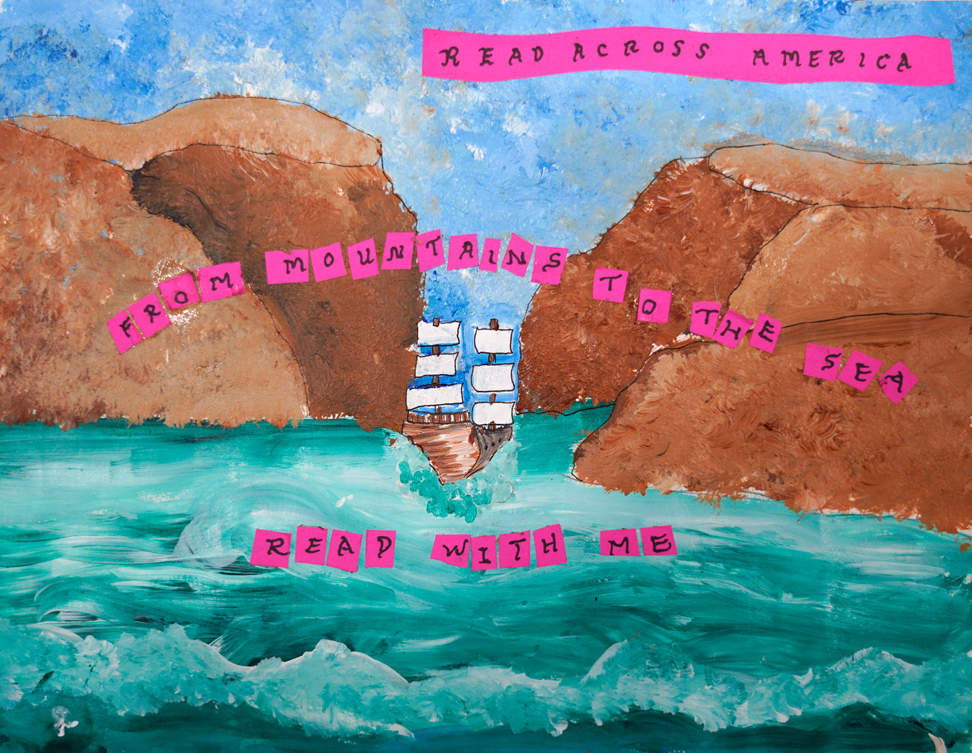
Honorable Mention
Kenya Pauling
Division 3: 6 – 8th Grade
Fairfield Magnet School
for Math & Science
Fairfield School District
Teacher: Kimi Daly

Slide 26
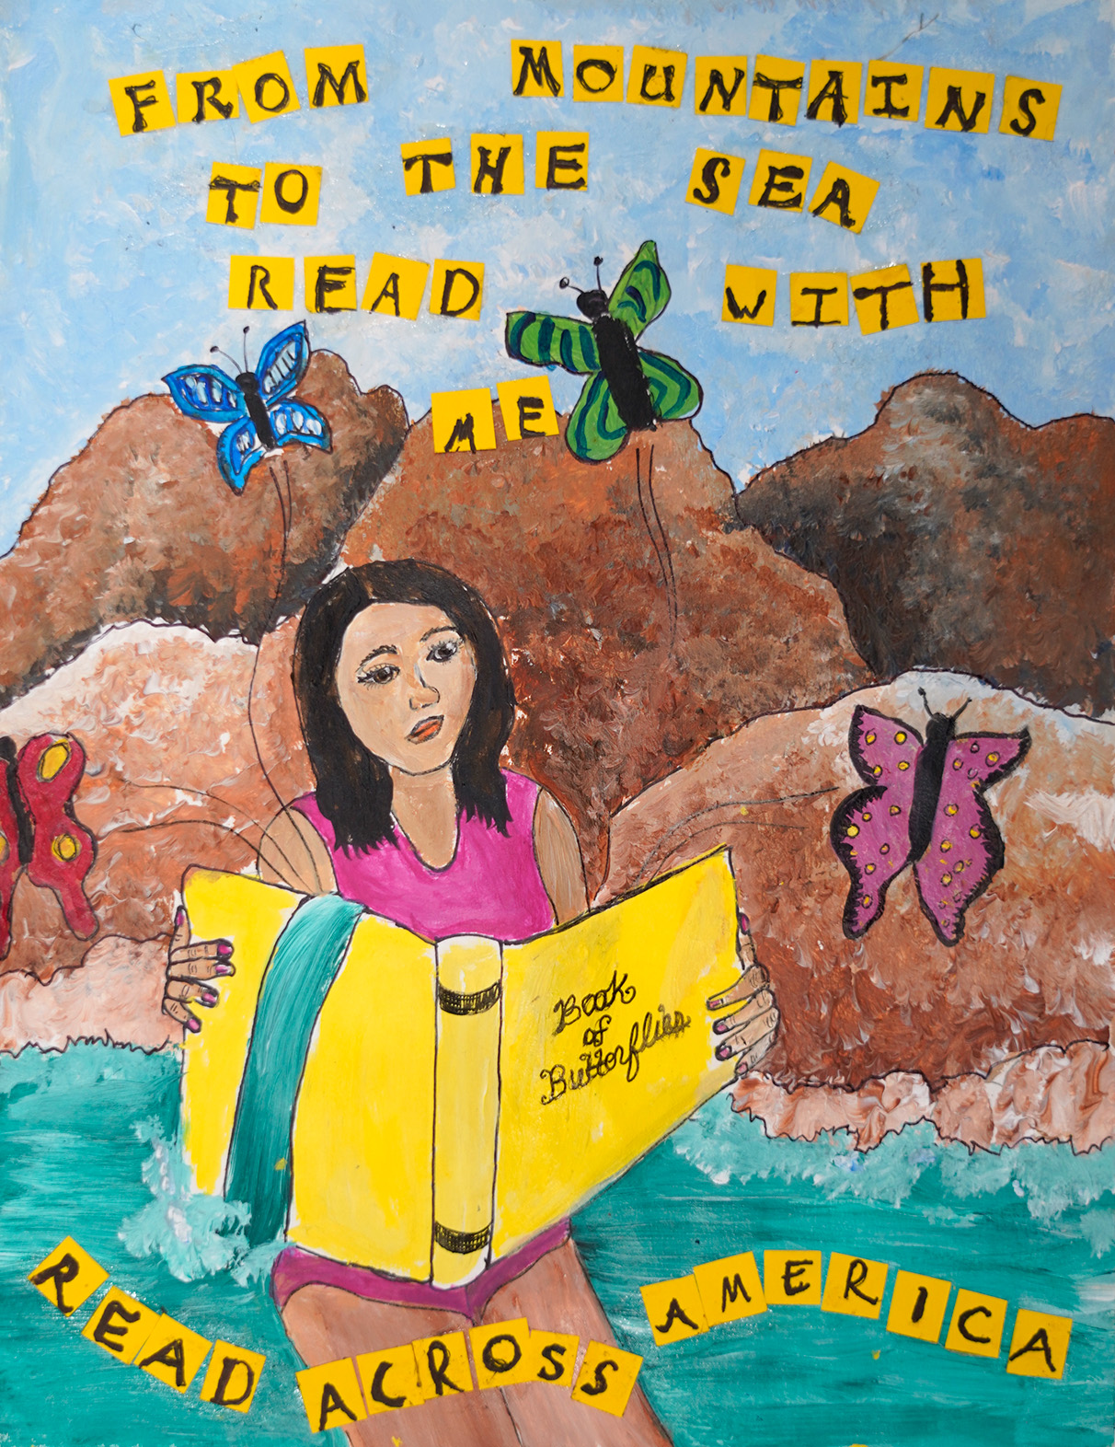
Honorable Mention
Taylor Tucker
Division 3: 6 – 8th Grade
Fairfield Magnet School
for Math & Science
Fairfield School District
Teacher: Kimi Daly

Slide 27
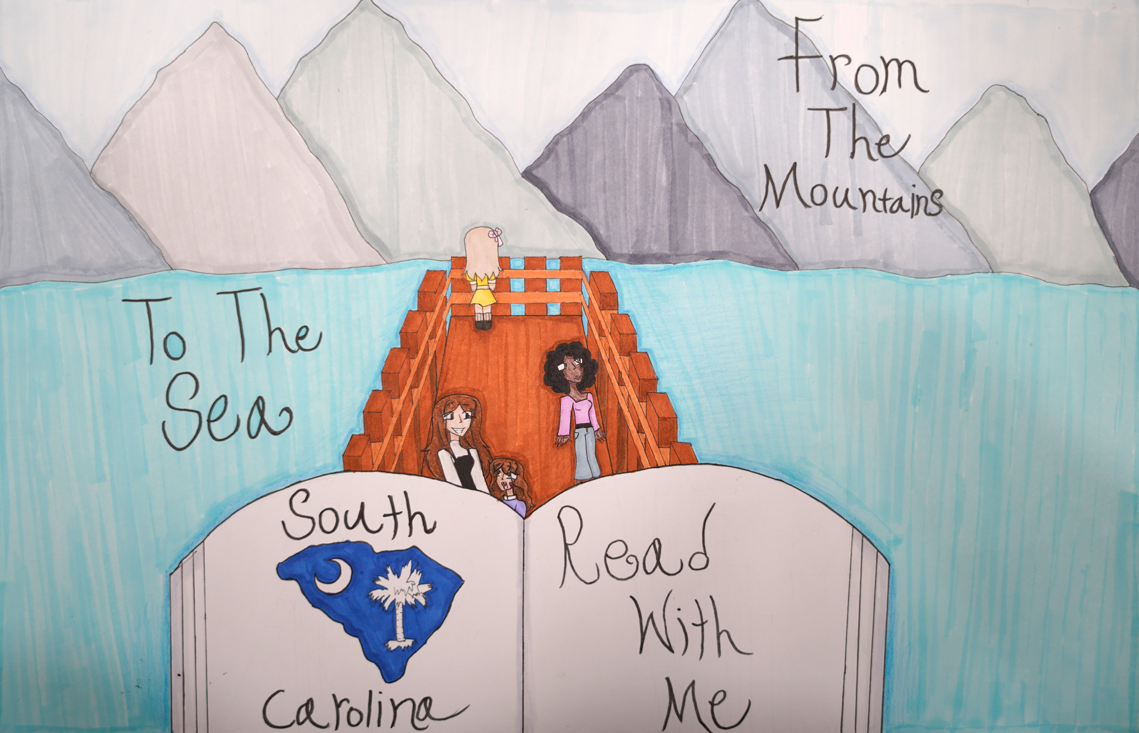
Honorable Mention
Nicole Ortiz
Division 3: 6 – 8th Grade
William J. Clark Middle School
Orangeburg School District
Teacher: Malissa Wright

Slide 28
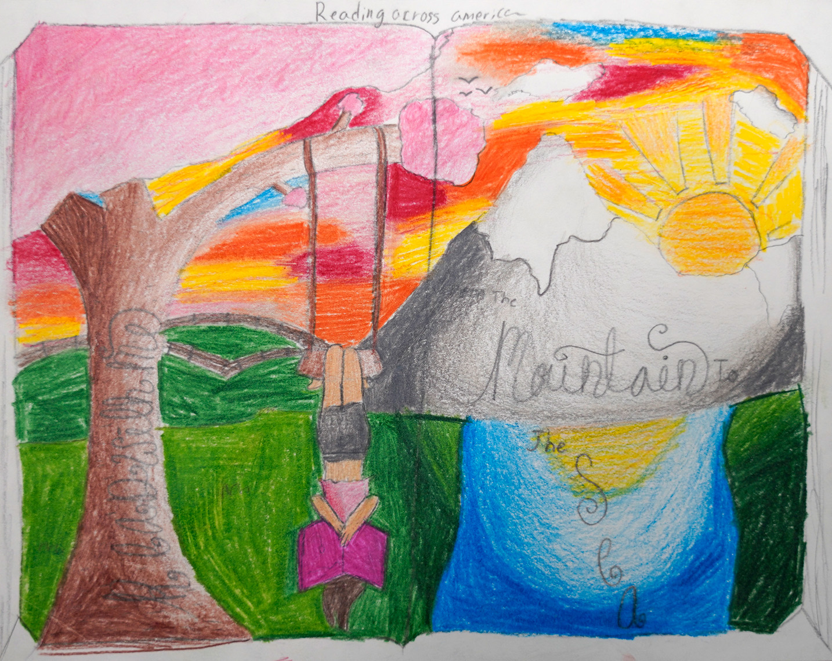
3rd Place Winner
Alexandria Sidati
Division 3: 6 – 8th Grade
Southside Middle School
Florence County
School District One
Teacher: Amy Carmichael

Slide 29
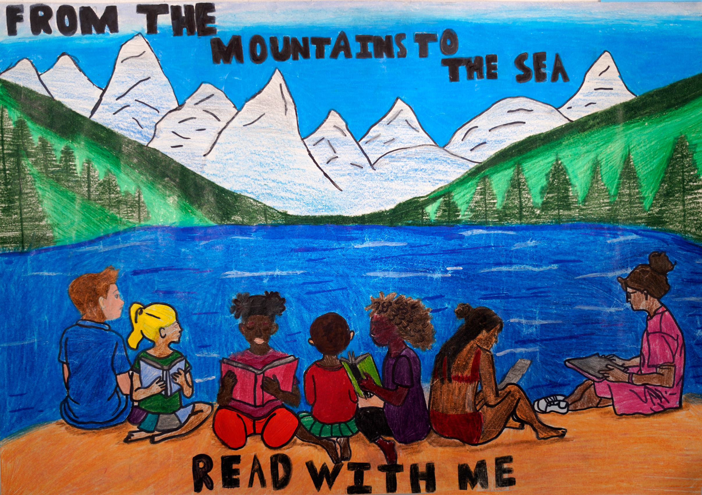
2nd Place Winner
Aliya Patel
Division 3: 6 – 8th Grade
William J. Clark Middle School
Orangeburg County School District
Teacher: Malissa Wright

Slide 30
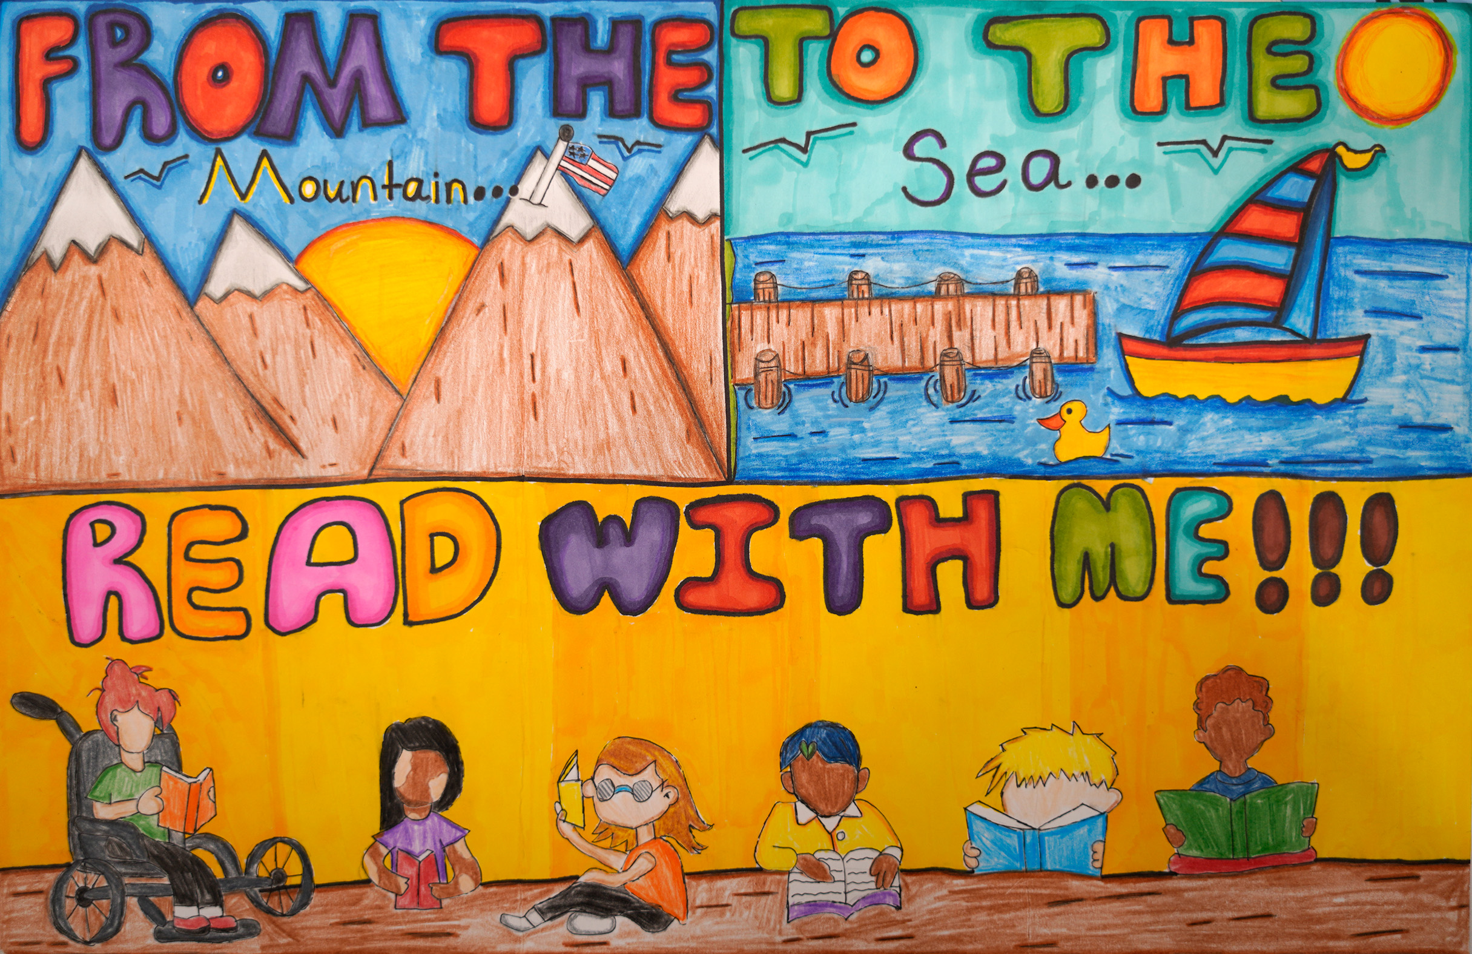
1st Place Winner
Jordyn Simpson
Division 3: 6 – 8th Grade
William J. Clark Middle School
Orangeburg County School District
Teacher: Malissa Wright

Slide 31
Division 4
Grades 9 - 12

Slide 32
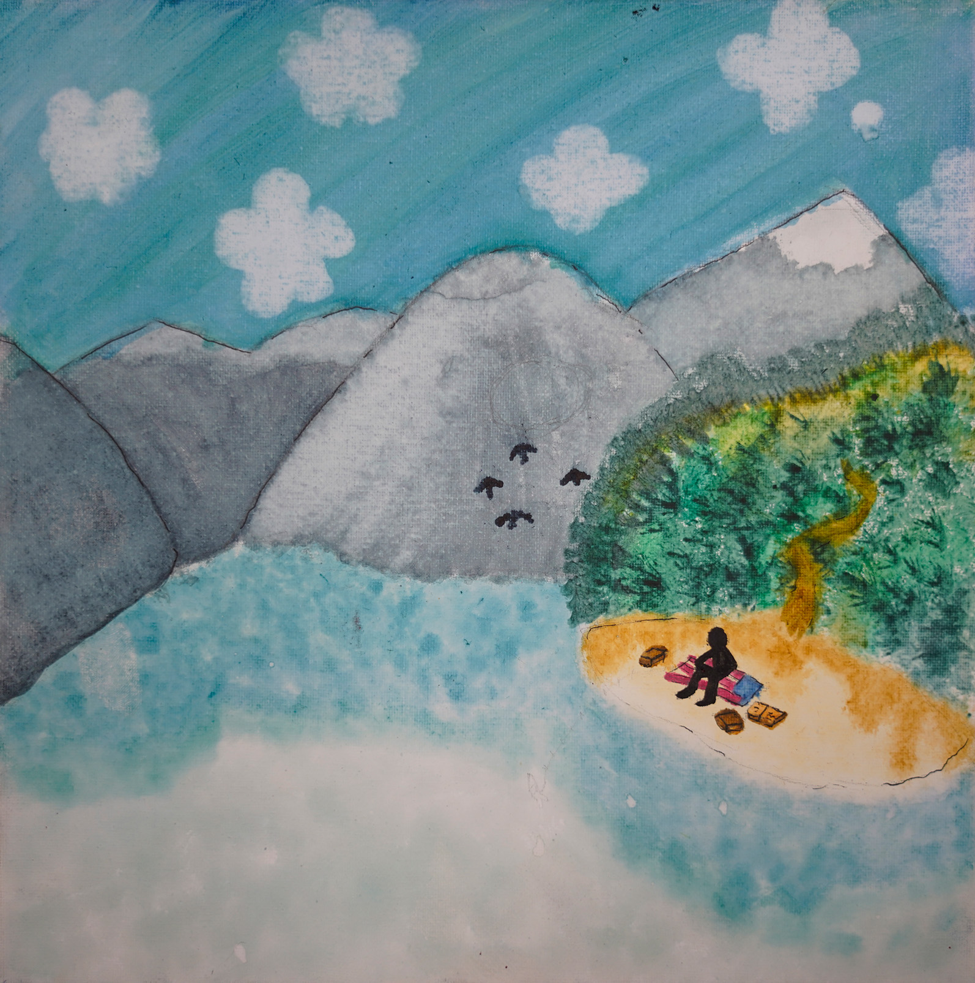
Honorable Mention
Chastity Bell
Division 4: 9 – 12th Grade
Williston-Elko High School
Barnwell School District
Teachers: Morgan Sanders

Slide 33
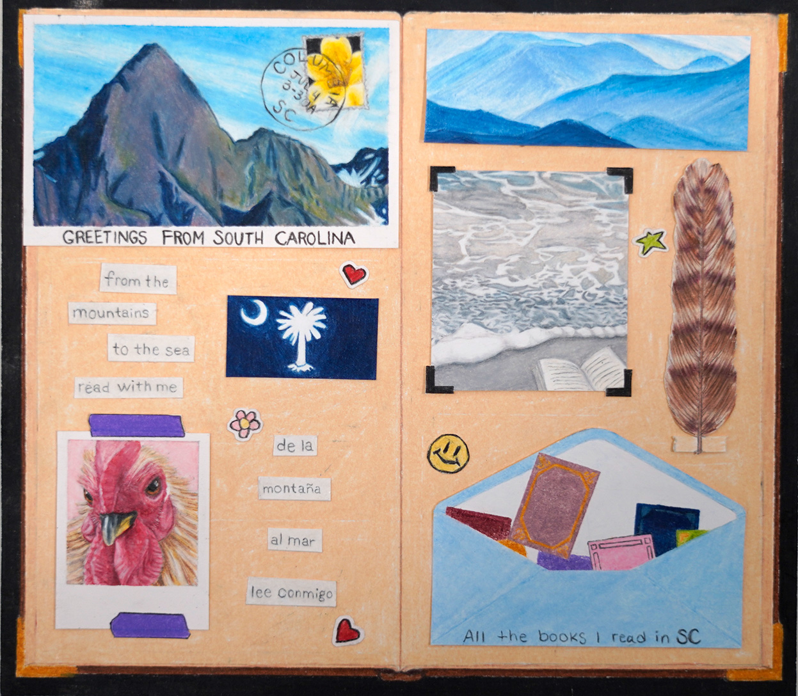
Honorable Mention
Leila Lee Haines
Division 4: 9 – 12th Grade
Chapin High School
Lexington-Richland
School District
Teacher: Chad Boland

Slide 34
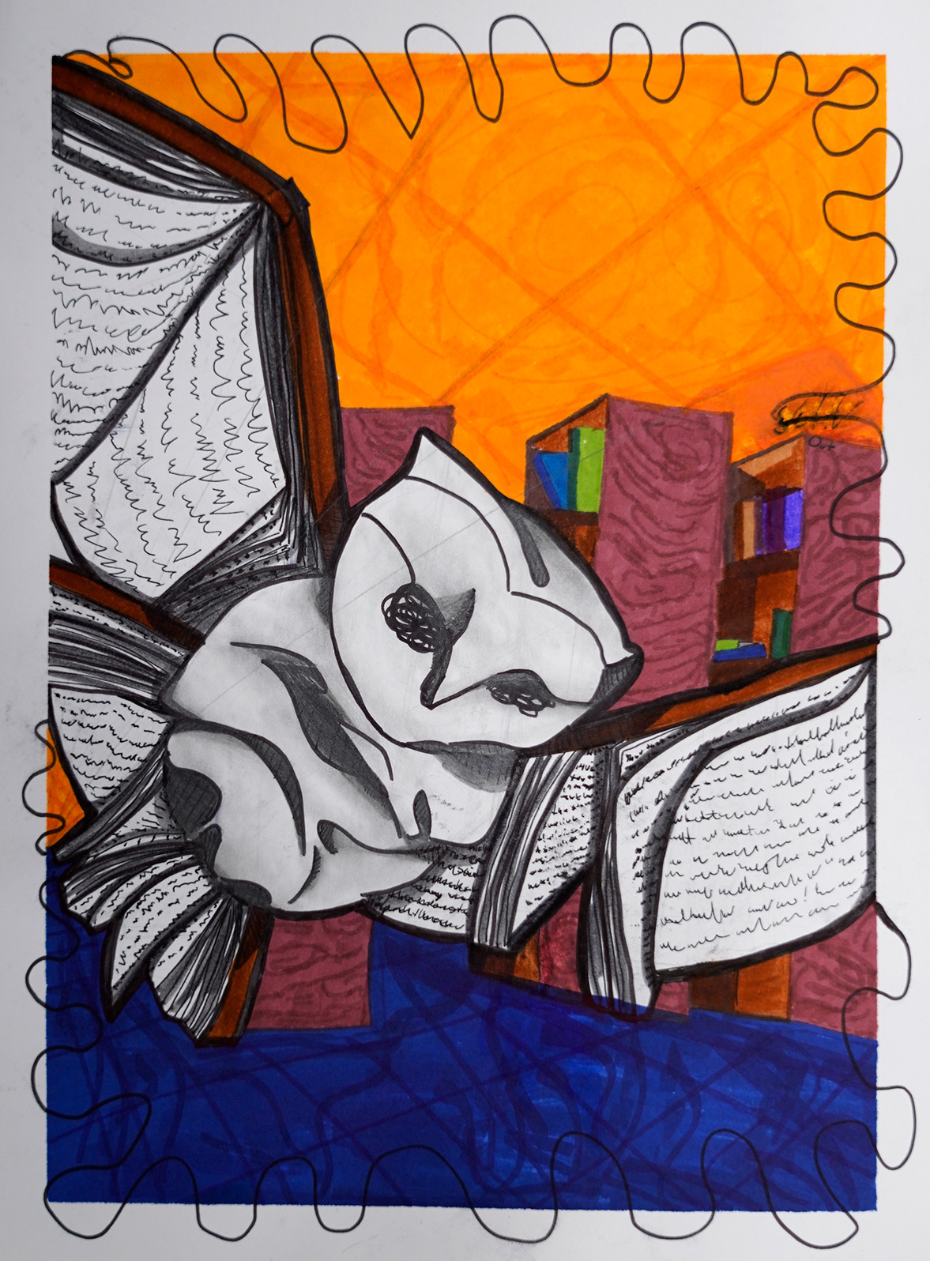
Honorable Mention
Sofia Hidalgo Villegas
Division 4: 9 – 12th Grade
North Myrtle Beach High School
Horry County School District
Teachers: Tina Martin and Lauren Woodward

Slide 35
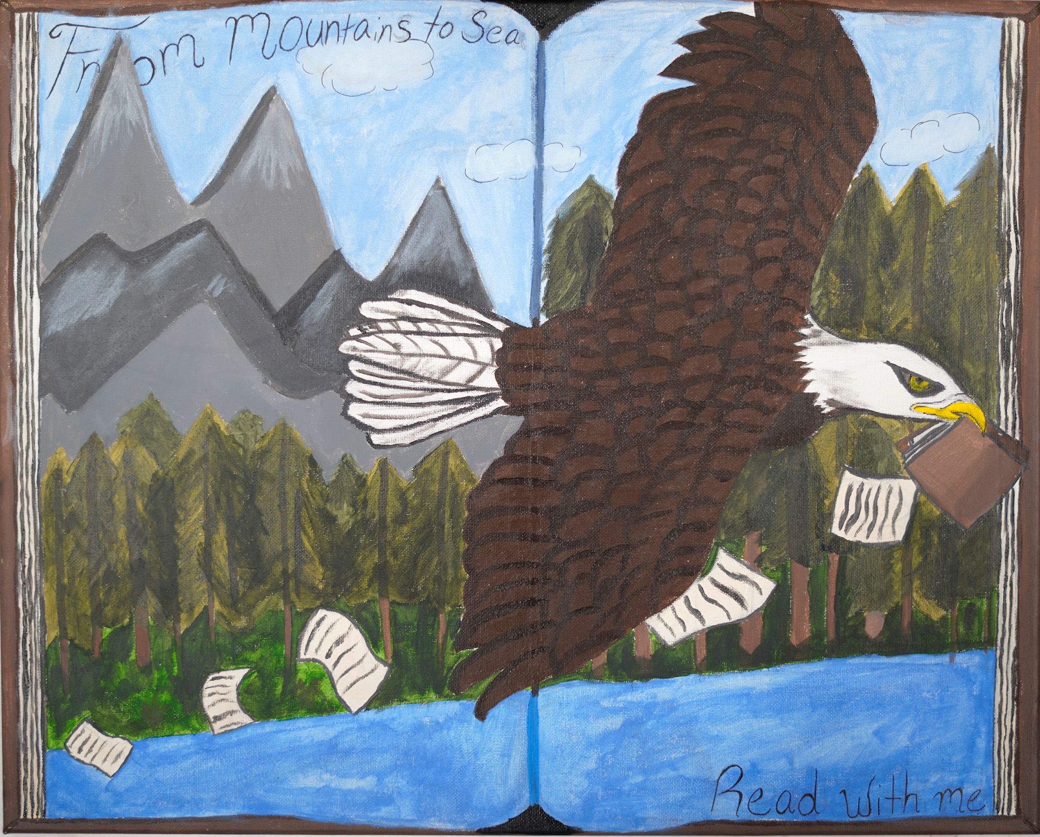
Honorable Mention
Laila Chavious
Division 4: 9 – 12th Grade
Williston-Elko High School
Barnwell School District
Teachers: Morgan Sanders

Slide 36
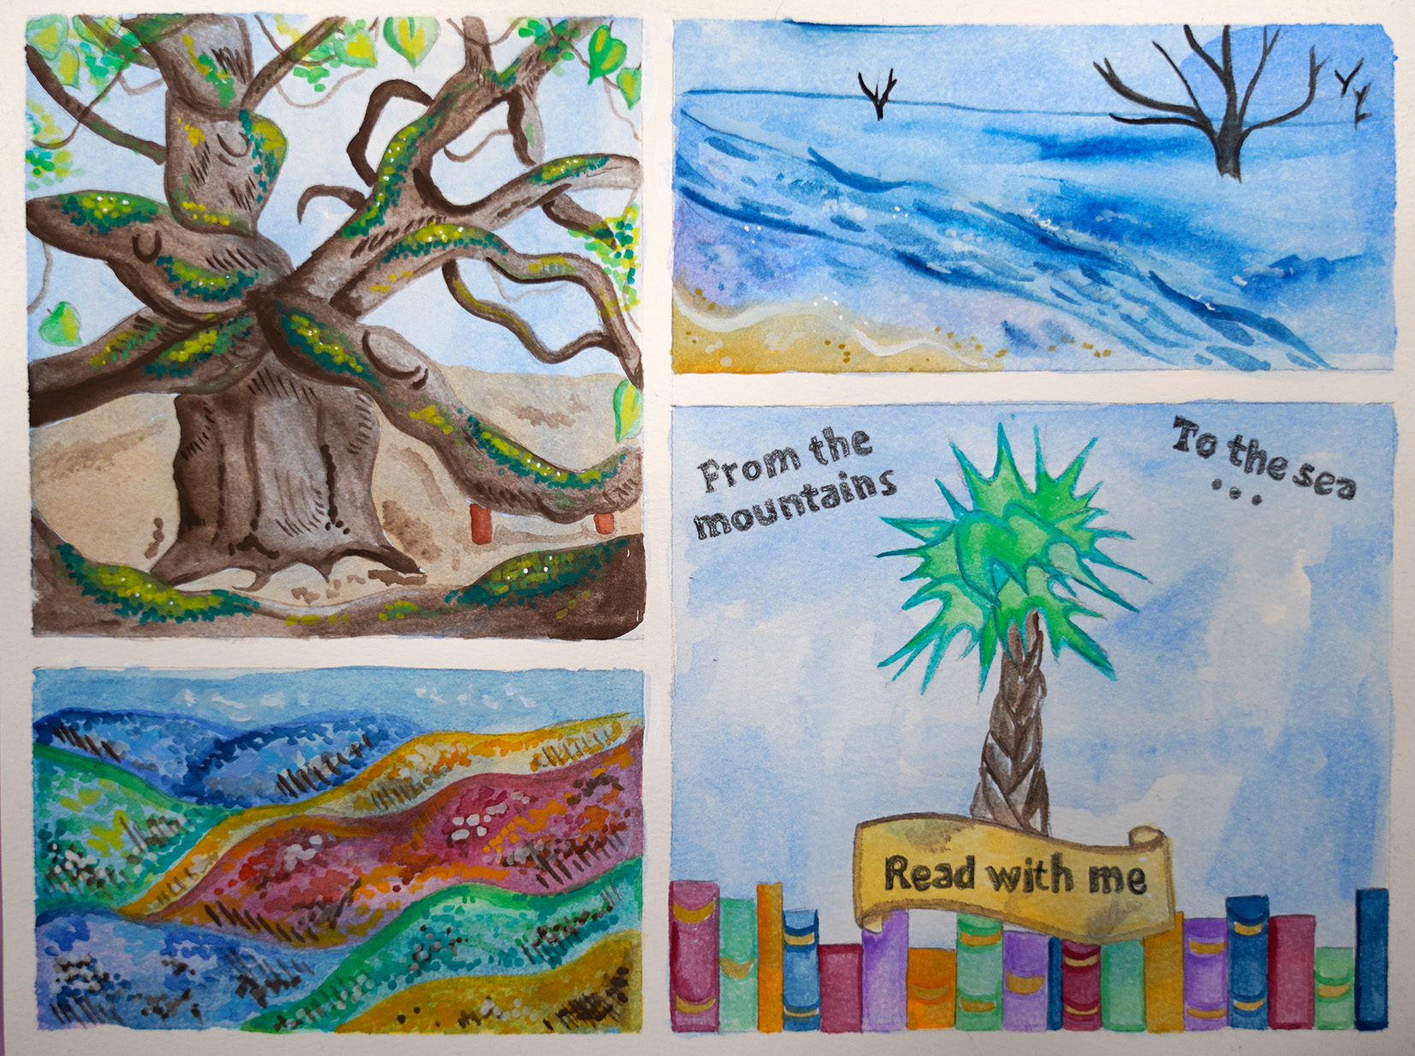
3rd Place Winner
Allison Wetmore
Division 4: 9 – 12th Grade
Chapin High School
Lexington-Richland School District
Teacher: Bethany Brown

Slide 37
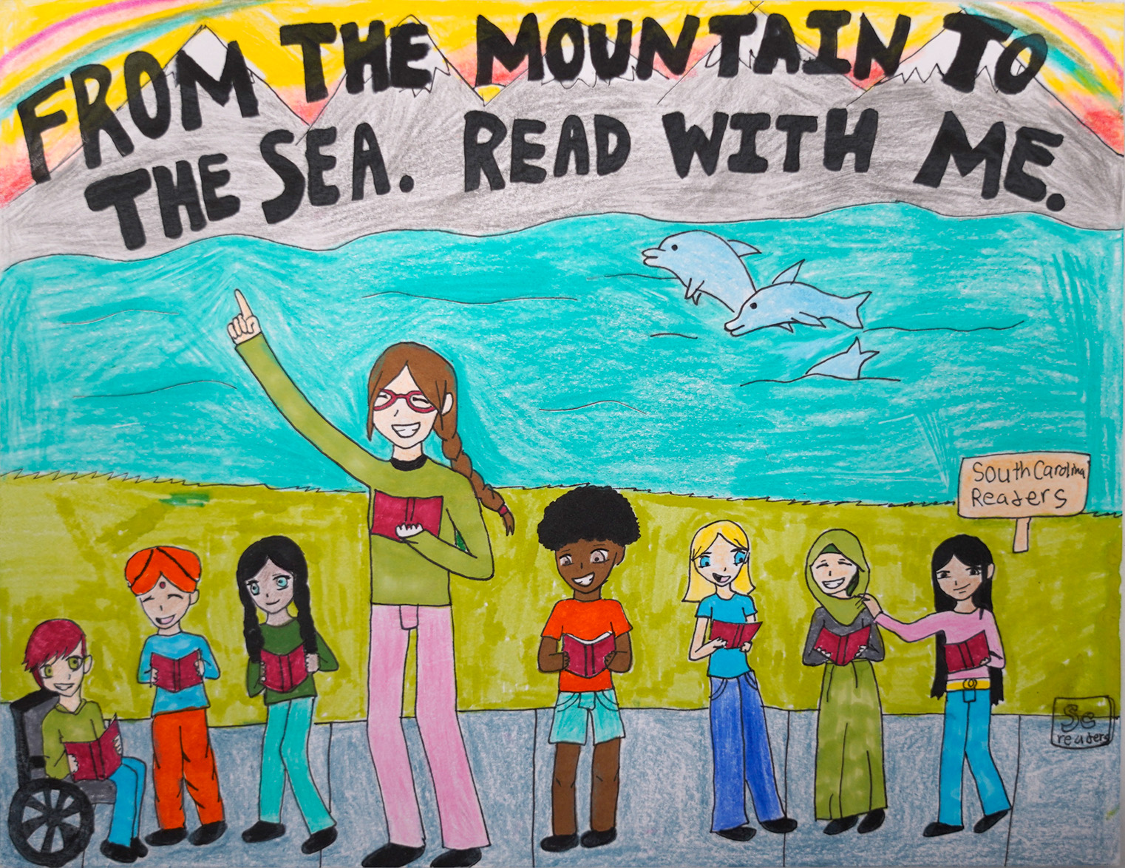
2nd Place Winner
Meynnah Wardlaw
Division 4: 9 – 12th Grade
Pendleton High School
Anderson County
School District
Teacher: Rachel Cox

Slide 38
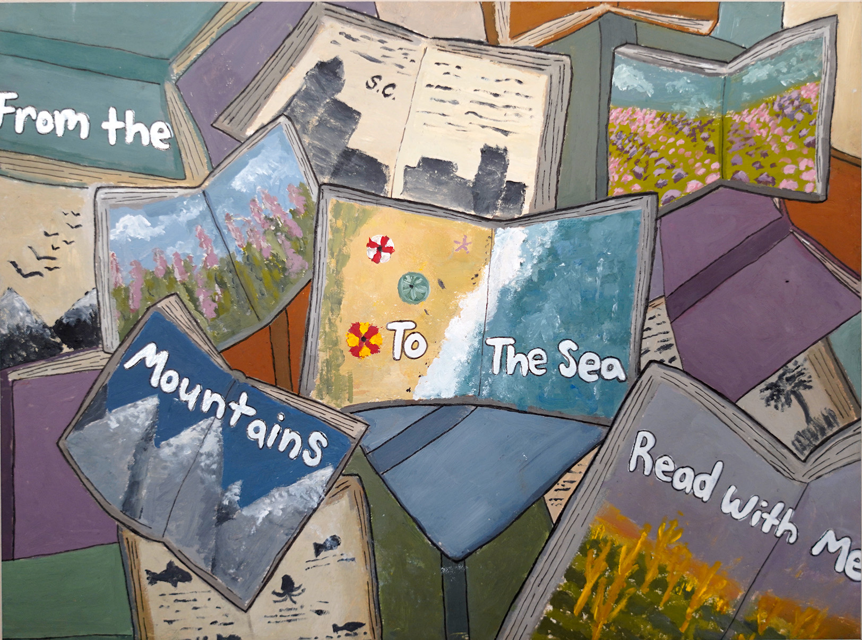
1st Place Winner
Skye Nutt
Division 4: 9 – 12th Grade
South Florence High School
Florence County School District
Teacher: Danielle Hubbard

Slide 39
Division 5
DIGITAL ART

Slide 40
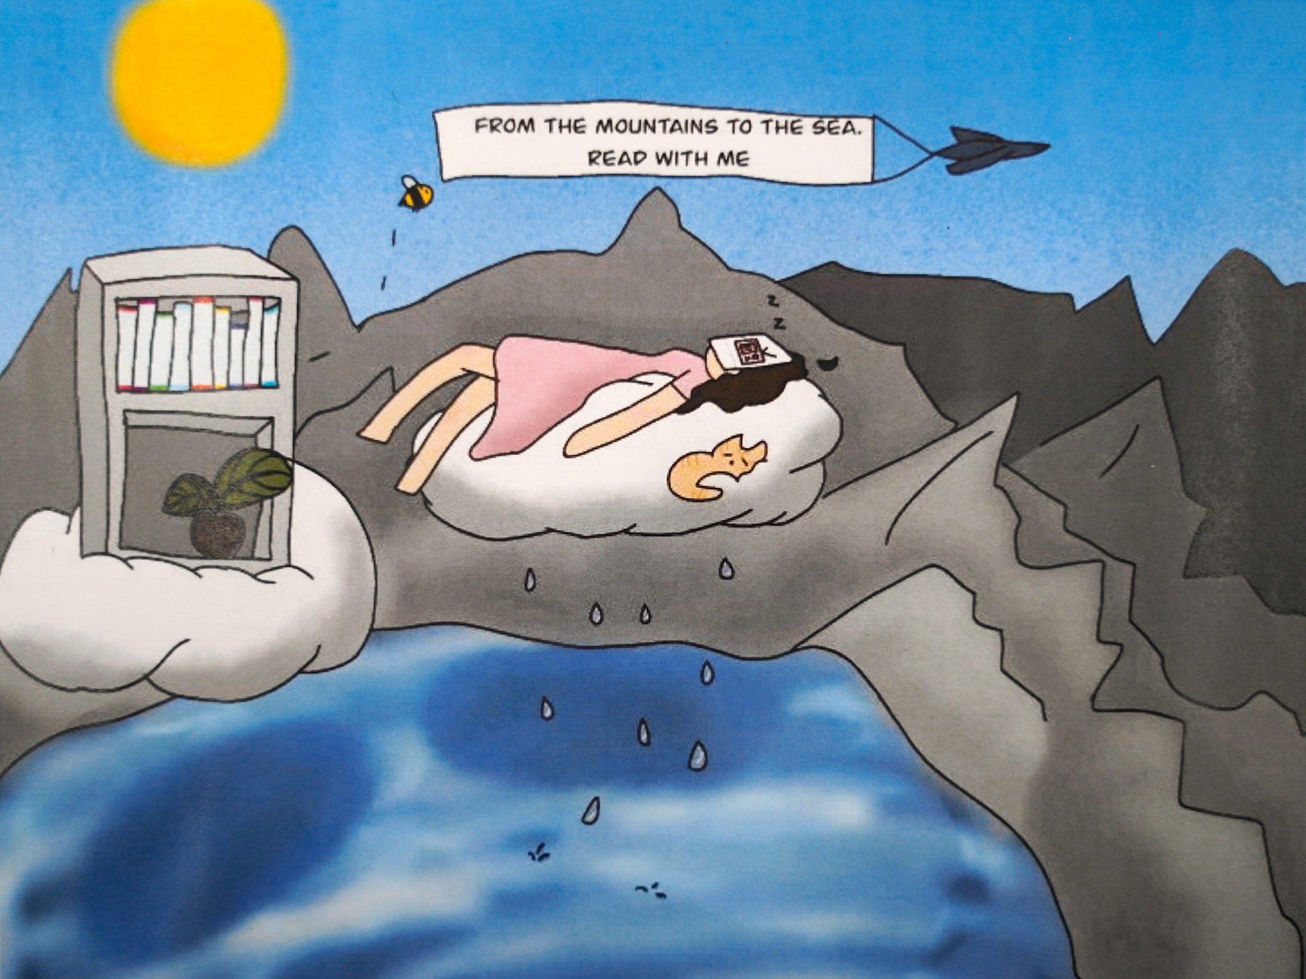
Honorable Mention
Anna Thomason
Division 5: Digital Art
Camperdown Academy
Greenville County
School District
Teacher: Ruth Thomas

Slide 41
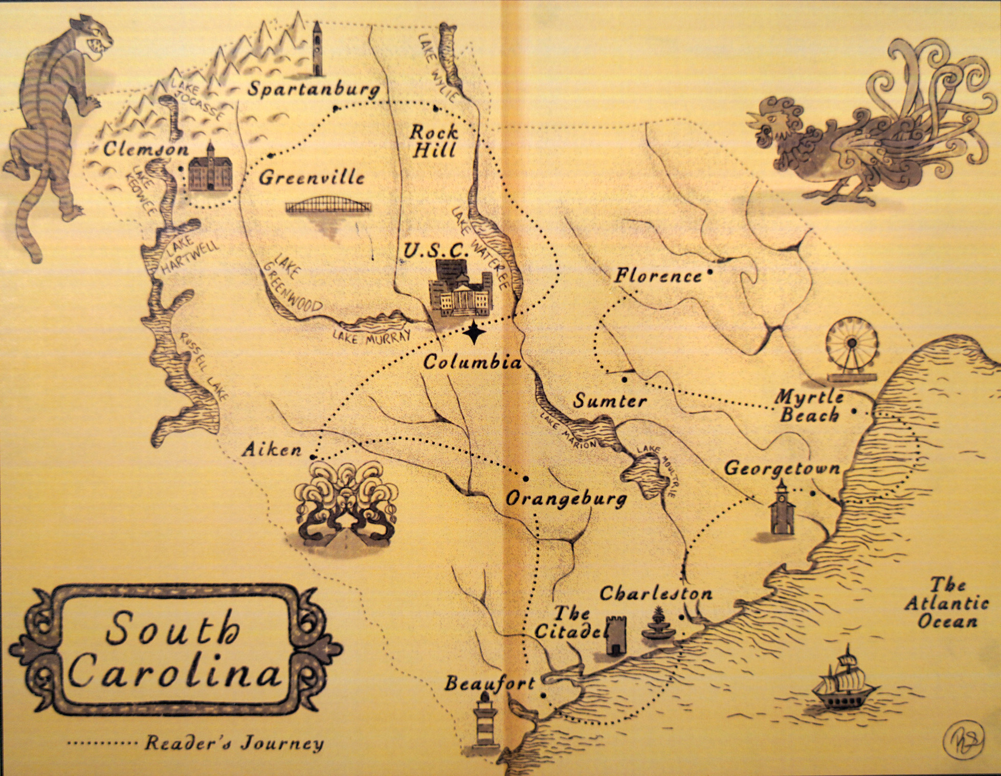
Honorable Mention
Reagan Sherrard
Division 5: Digital Art
Chapin High School
Lexington-Richland School District
Teacher: Bethany Brown

Slide 42
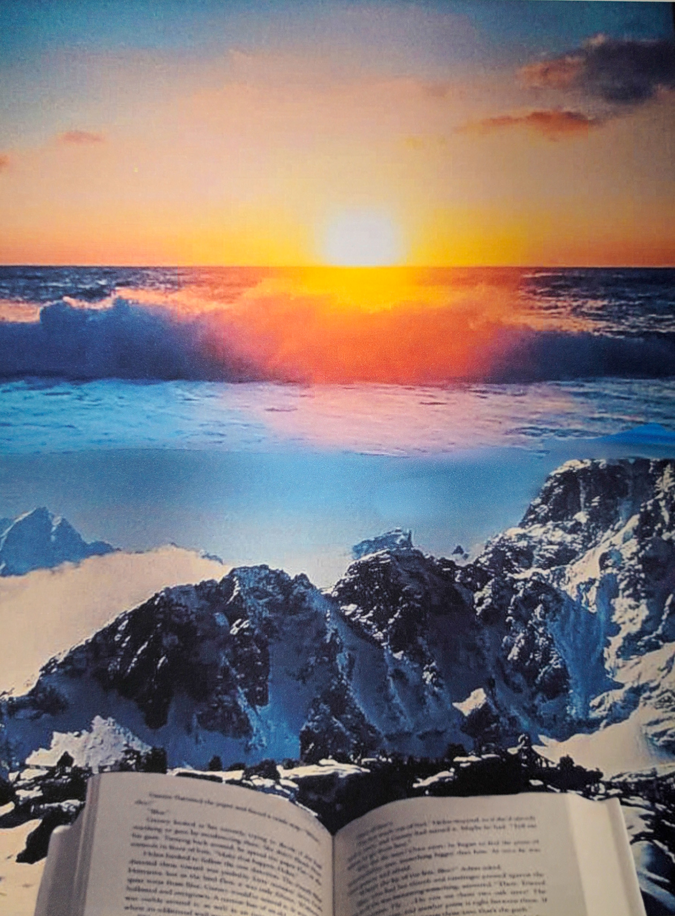
Honorable Mention
Ivette Garcia-Vasquez
Division 5: Digital Art
West Florence High School
Florence County
School District
Teacher: Emily Shokes

Slide 43
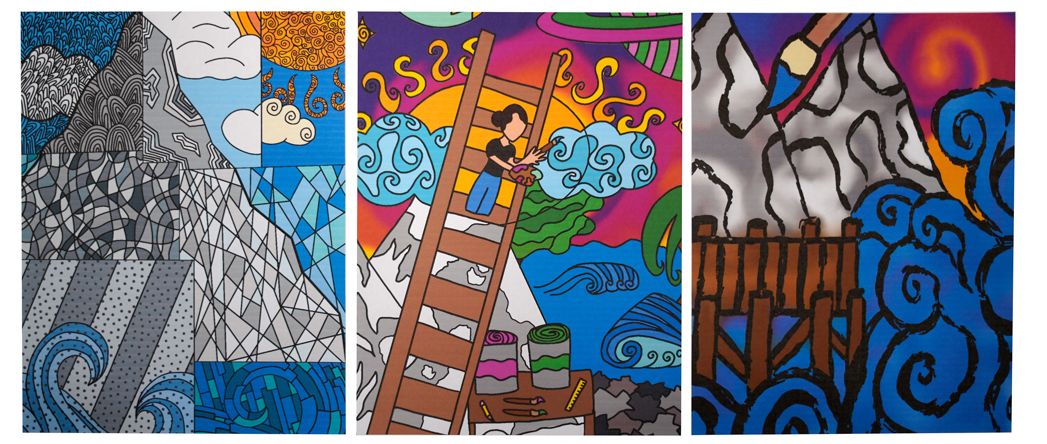
Honorable Mention
Chloe McKenzie
Division 5: Digital Art
Keenan High School
Richland County
School District
Teacher: Jay Watkins

Slide 44

Honorable Mention
Saniya Patel
Division 5: Digital Art
William J. Clarke Middle School
Orangeburg County
School District
Teacher: Malissa Wright

Slide 45

3rd Place Winner
Andrea Nikolakakos
Division 5: Digital Art
West Florence High School
Florence County School District
Teacher: Emily Shokes

Slide 46
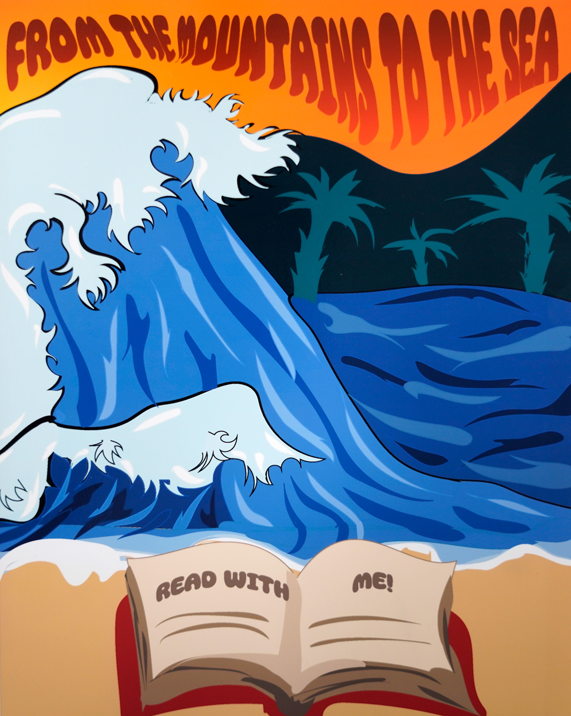
2nd Place Winner
Bryson Thomas
Division 5: Digital Art
South Florence High School
Florence School District One
Teacher: Danielle Hubbard

Slide 47
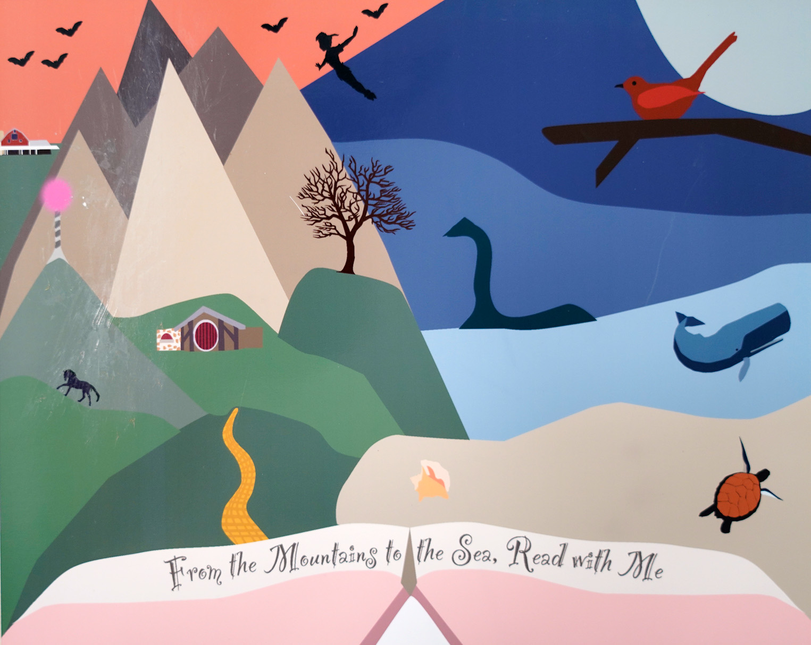
1st Place Winner
Isabella McJunkin
Division 5: Digital Art
South Florence High School
Florence School District One
Teacher: Danielle Hubbard

Slide 48
Division 6
Photography

Slide 49
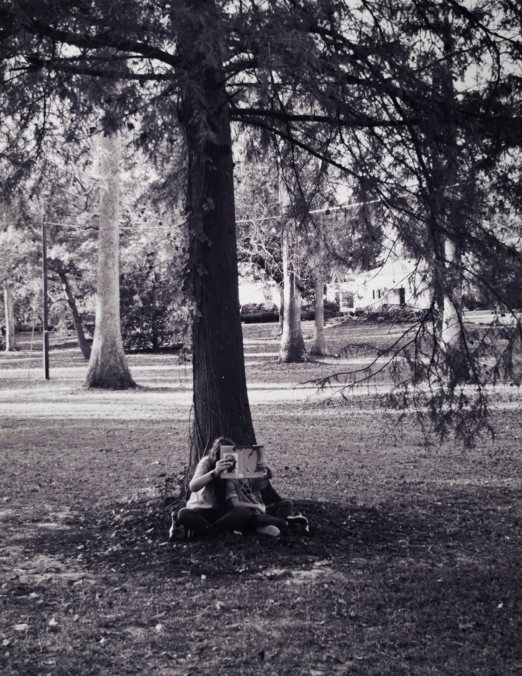
Honorable Mention
Luke Matthews
Division 6: Photography
Southside Middle School
Florence County School District One
Teacher: Robin Voss

Slide 50

Honorable Mention
Ethan Mejia
Division 6: Photography
Southside Middle School
Florence County School District One
Teacher: Robin Voss

Slide 51
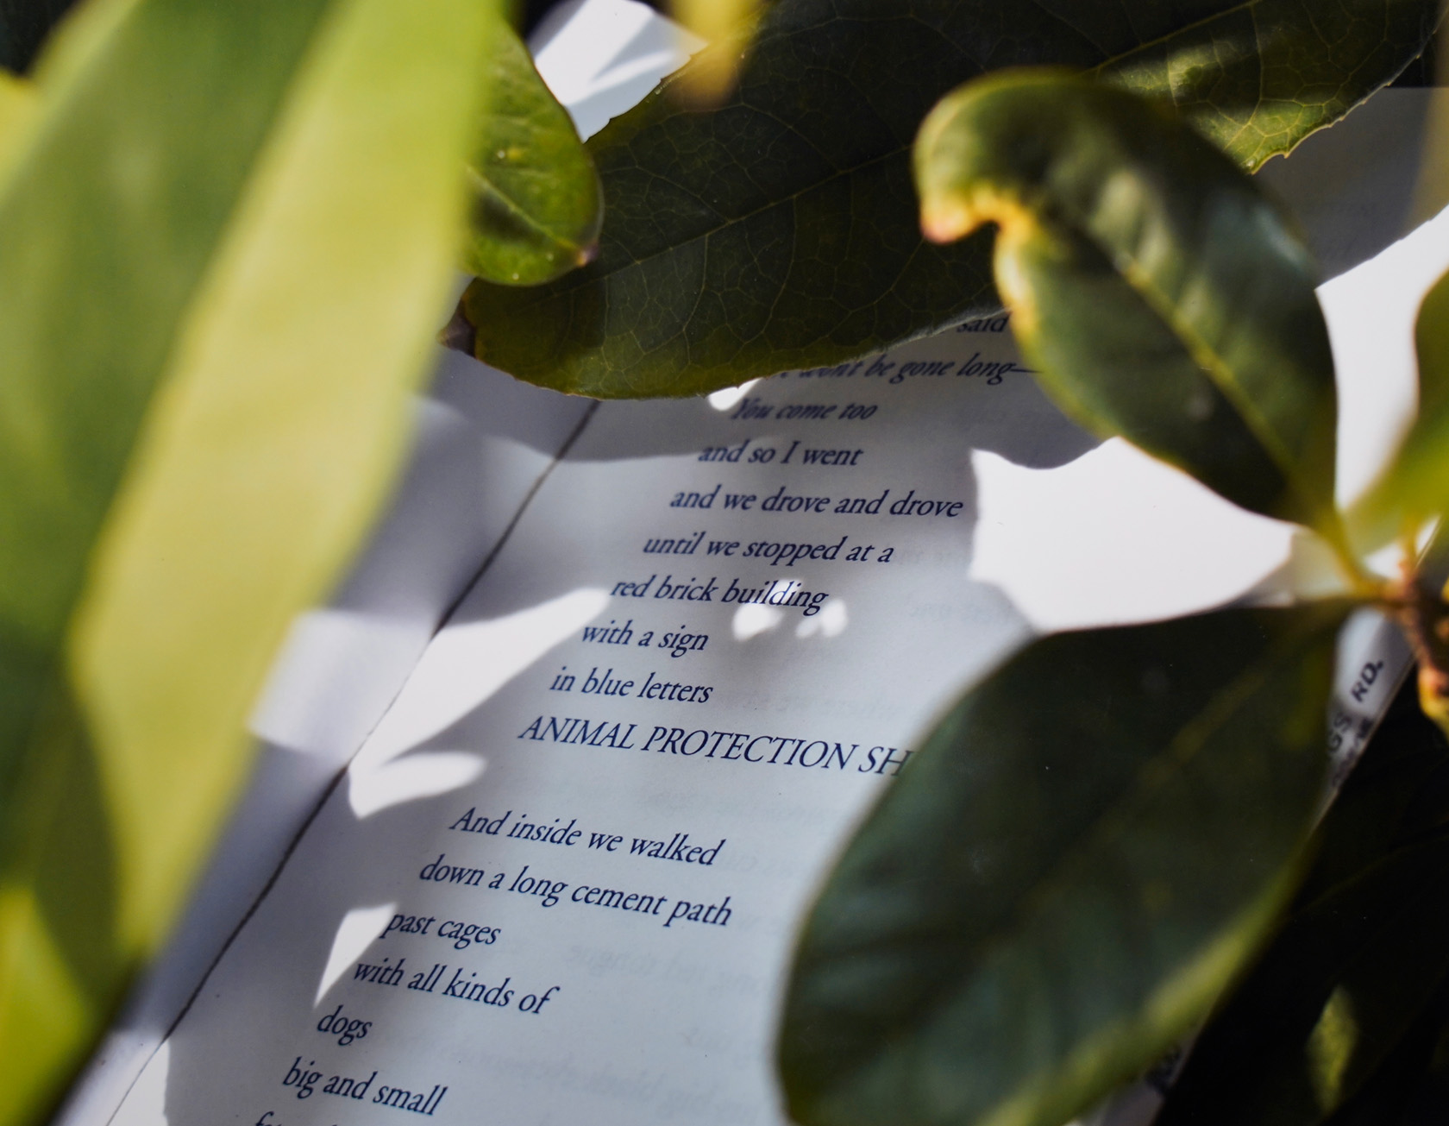
Honorable Mention
Isaiah Rodgers
Division 6: Photography
Southside Middle School
Florence County School District One
Teacher: Robin Voss

Slide 52
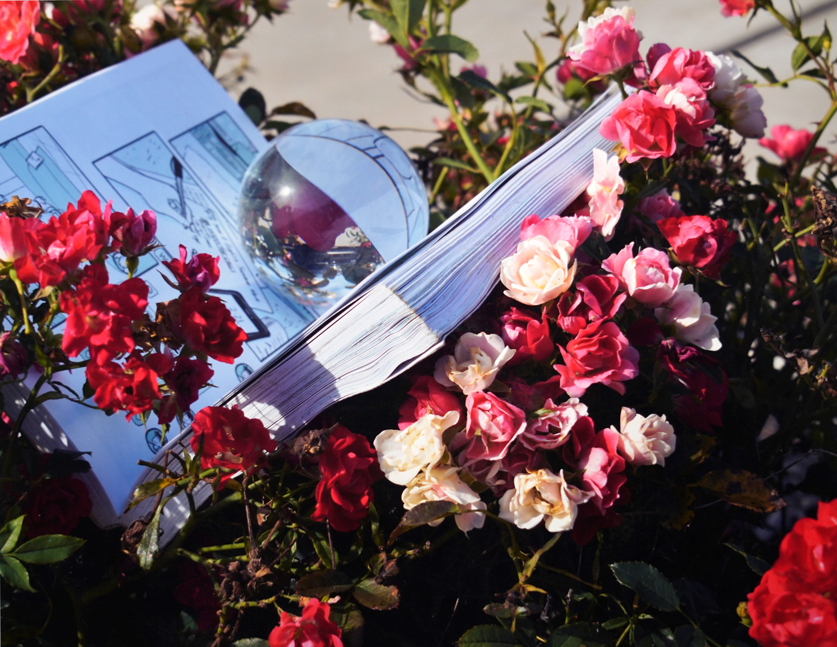
3rd Place Winner
Karsyn Thornton
Division 6: Photography
Southside Middle School
Florence County School District One
Teacher: Robin Voss

Slide 53
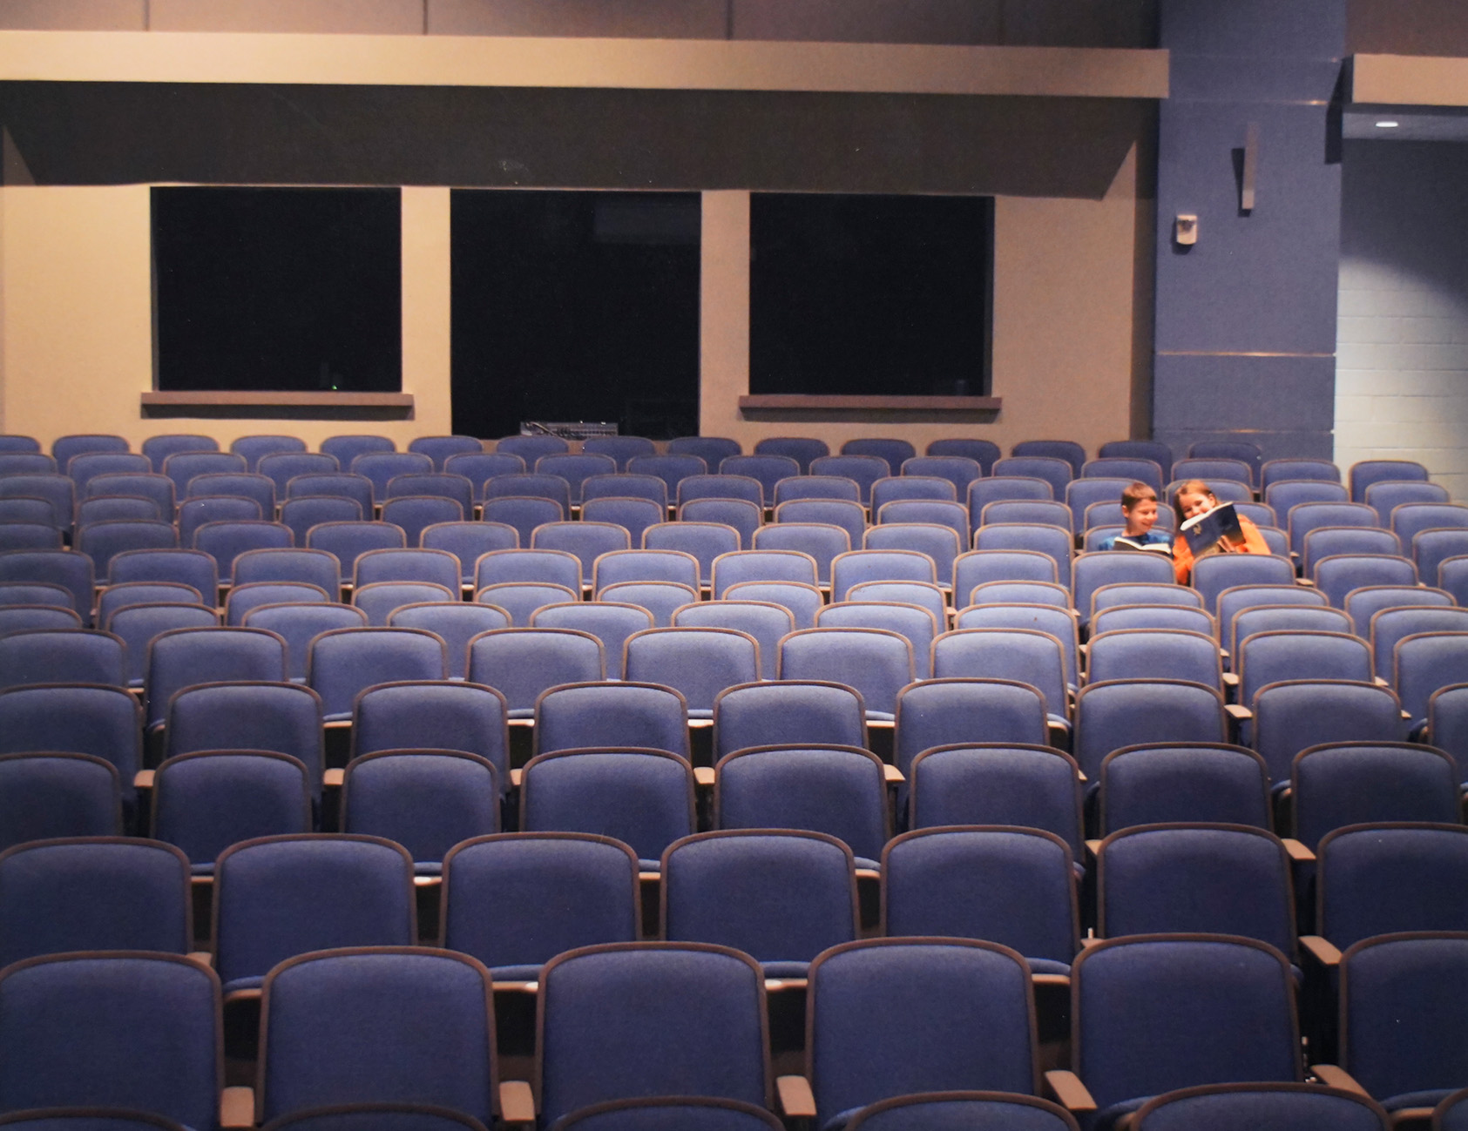
2nd Place Winner
Jones Dabney
Division 6: Photography
Southside Middle School
Florence County School District One
Teacher: Robin Voss

Slide 54
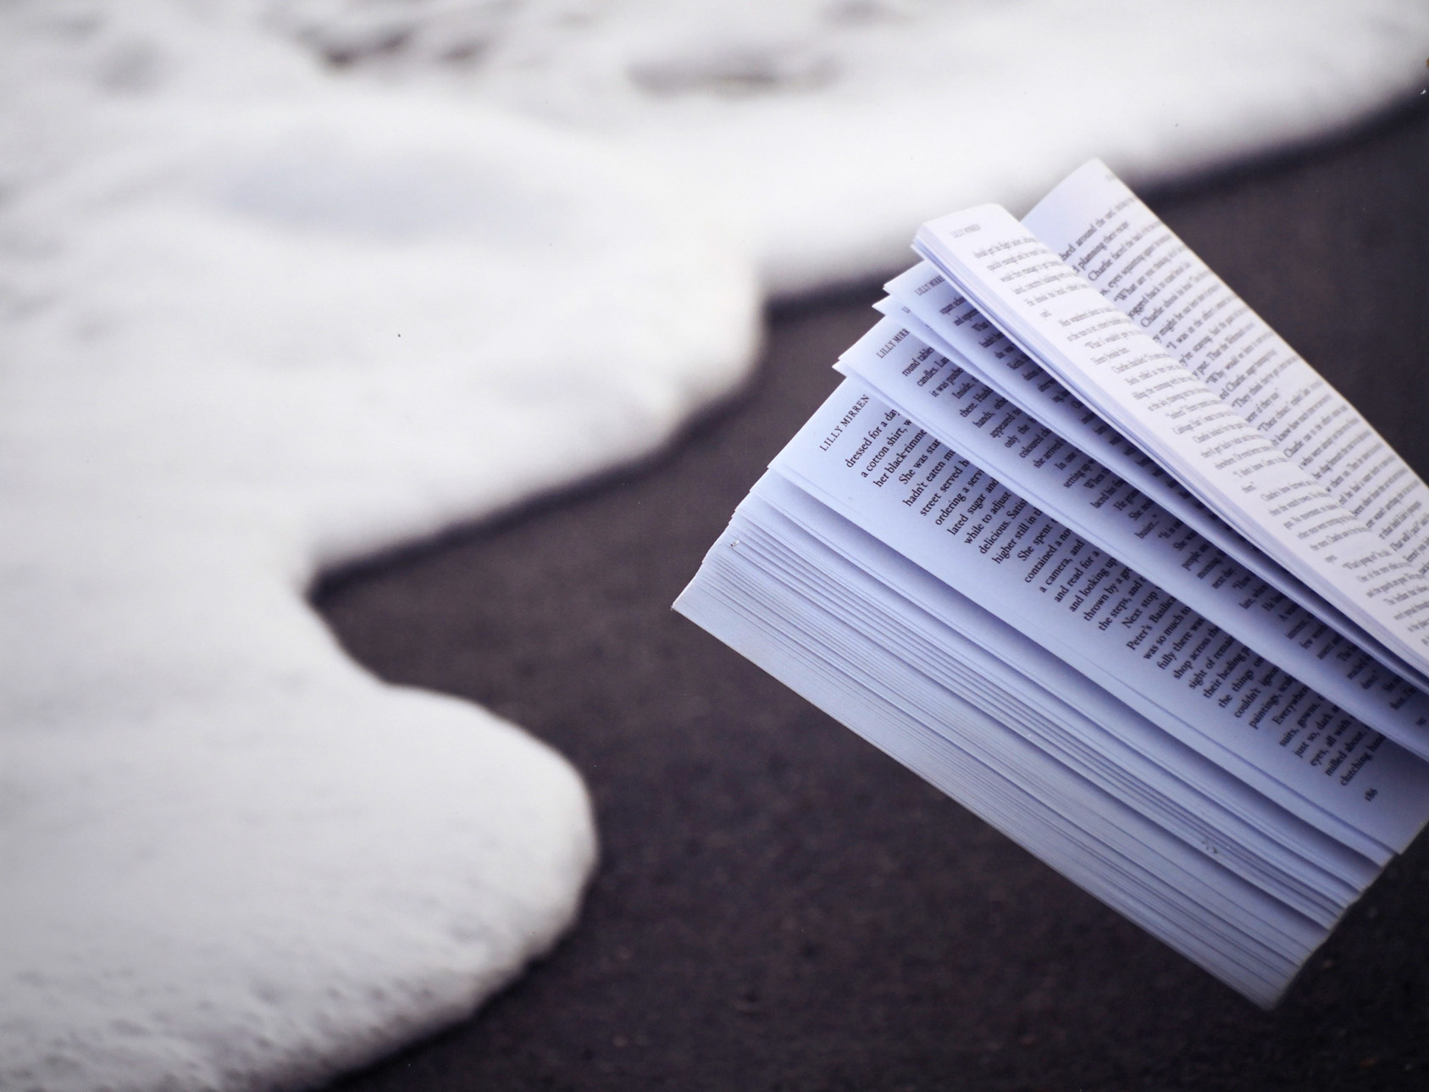
1st Place Winner
Steward Brown
Division 6: Photography
Southside Middle School
Florence County School District One
Teacher: Robin Voss

Slide 55
Division 7
Artistic Merit

Slide 56

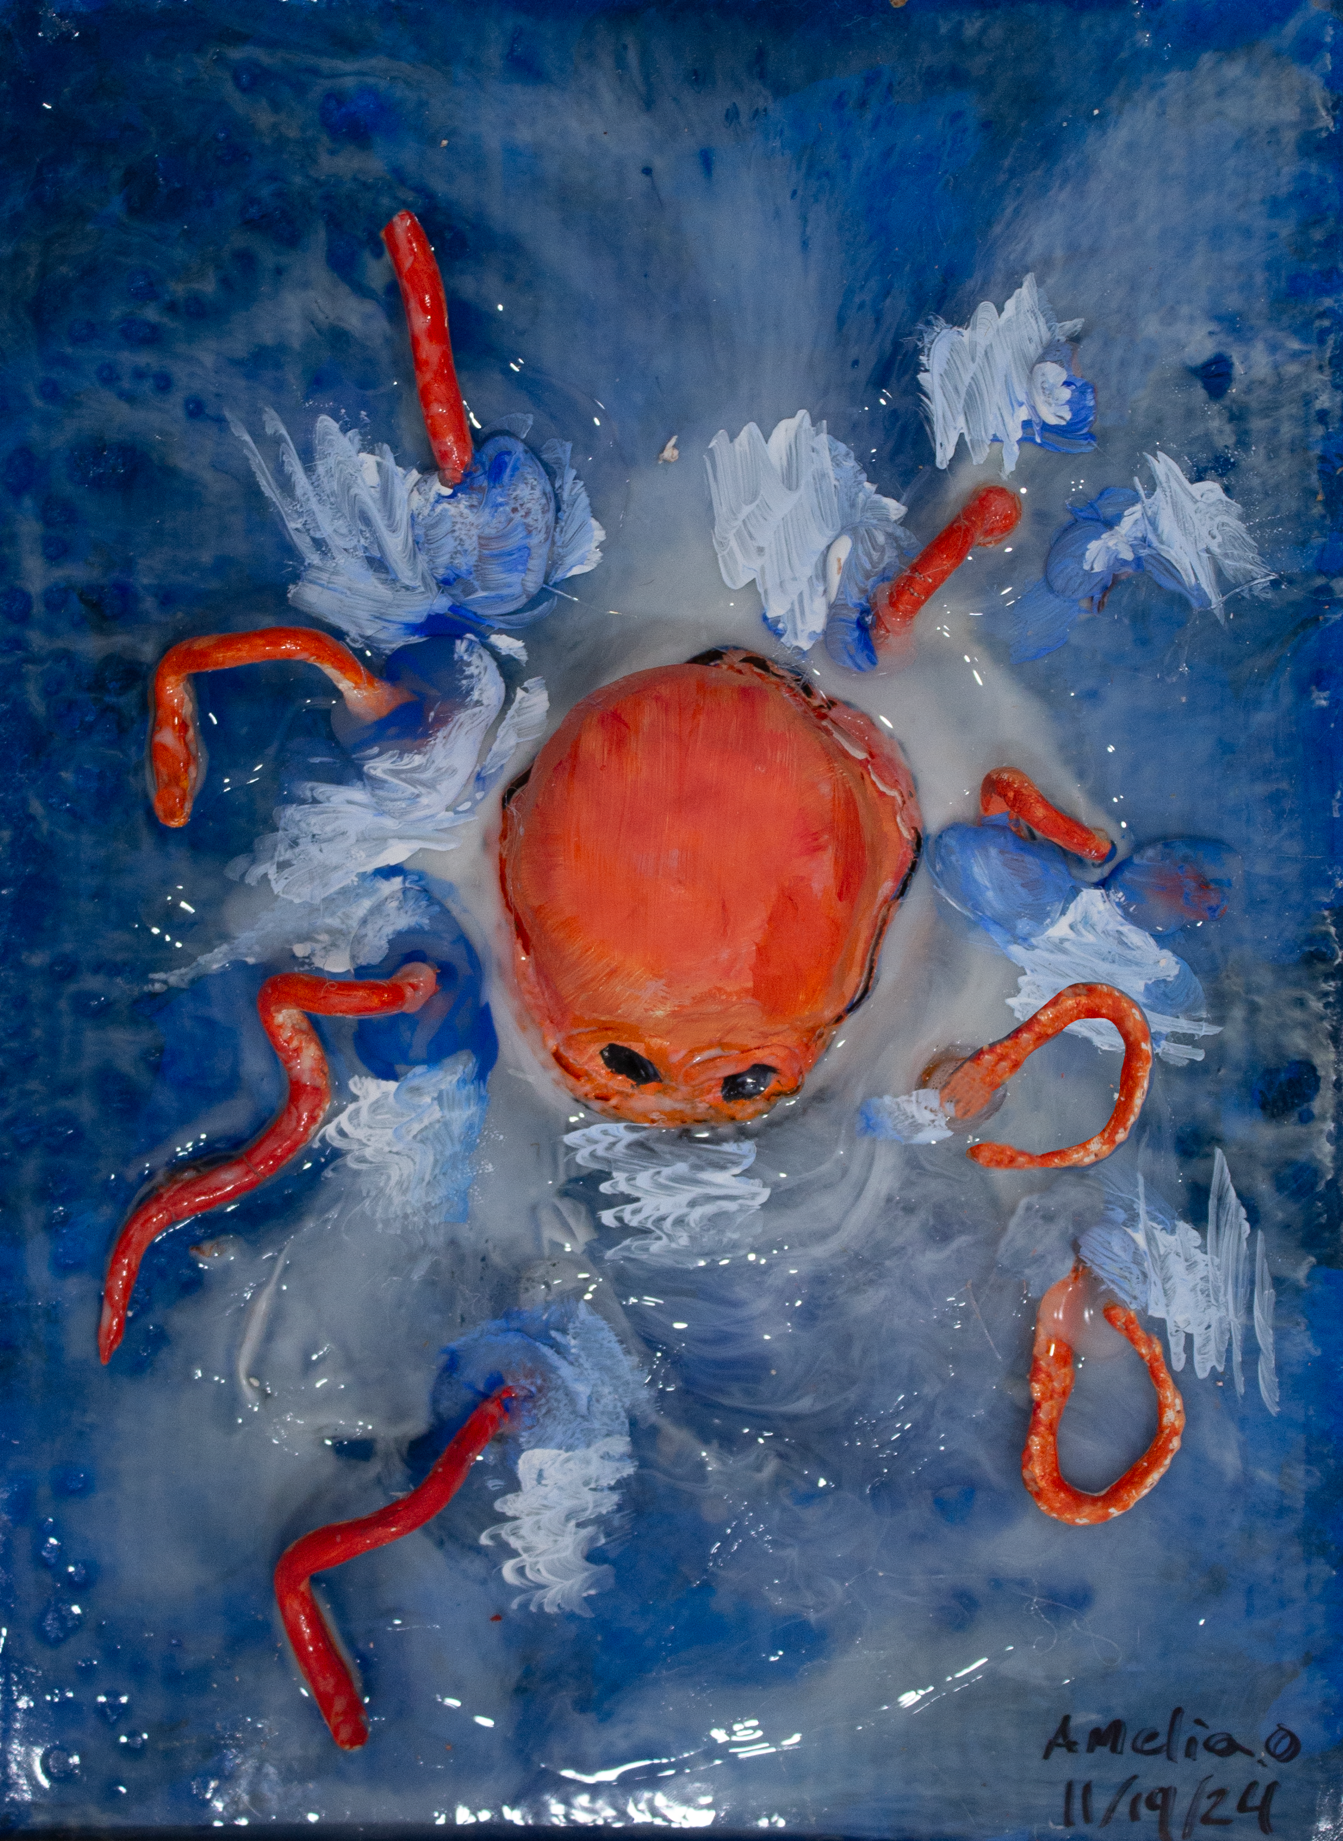
Artistic Merit
Amelia Owens
Ten Oaks Middle School
Horry County
School District
Teacher: Patrick Best

Slide 57
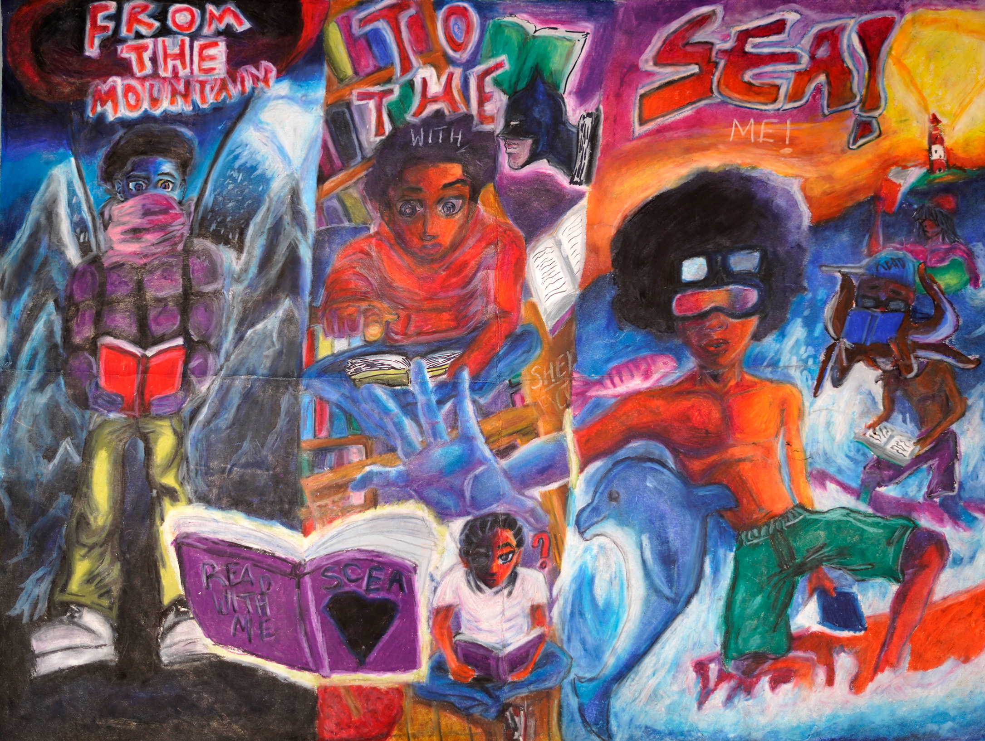
Artistic Merit
Steven Reed
Williston-Elko High School
Barnwell School District
Teacher: Morgan Sanders

Slide 58

Artistic Merit
Mya Moore
Ten Oaks Middle School
Horry County
School District
Teacher: Patrick Best

Slide 59
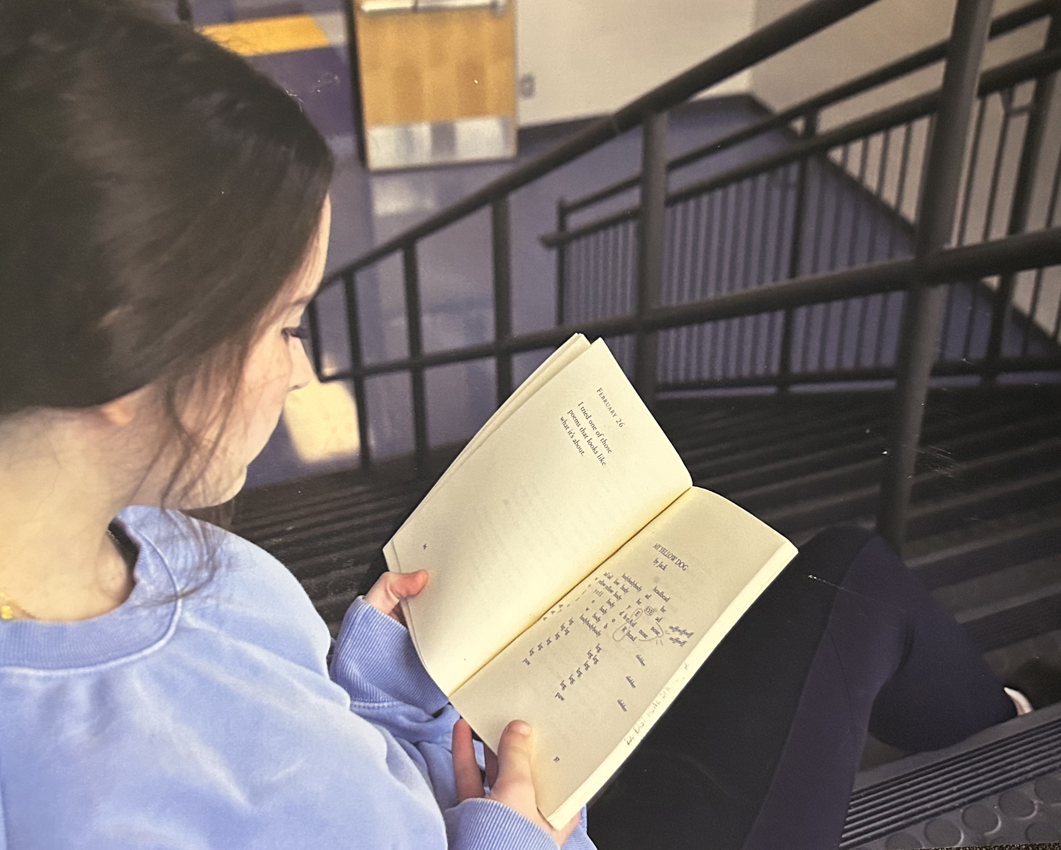
Artistic Merit
Piper McLeod
Southside Middle School
Florence County
School District
Teacher: Robin Voss

Slide 60
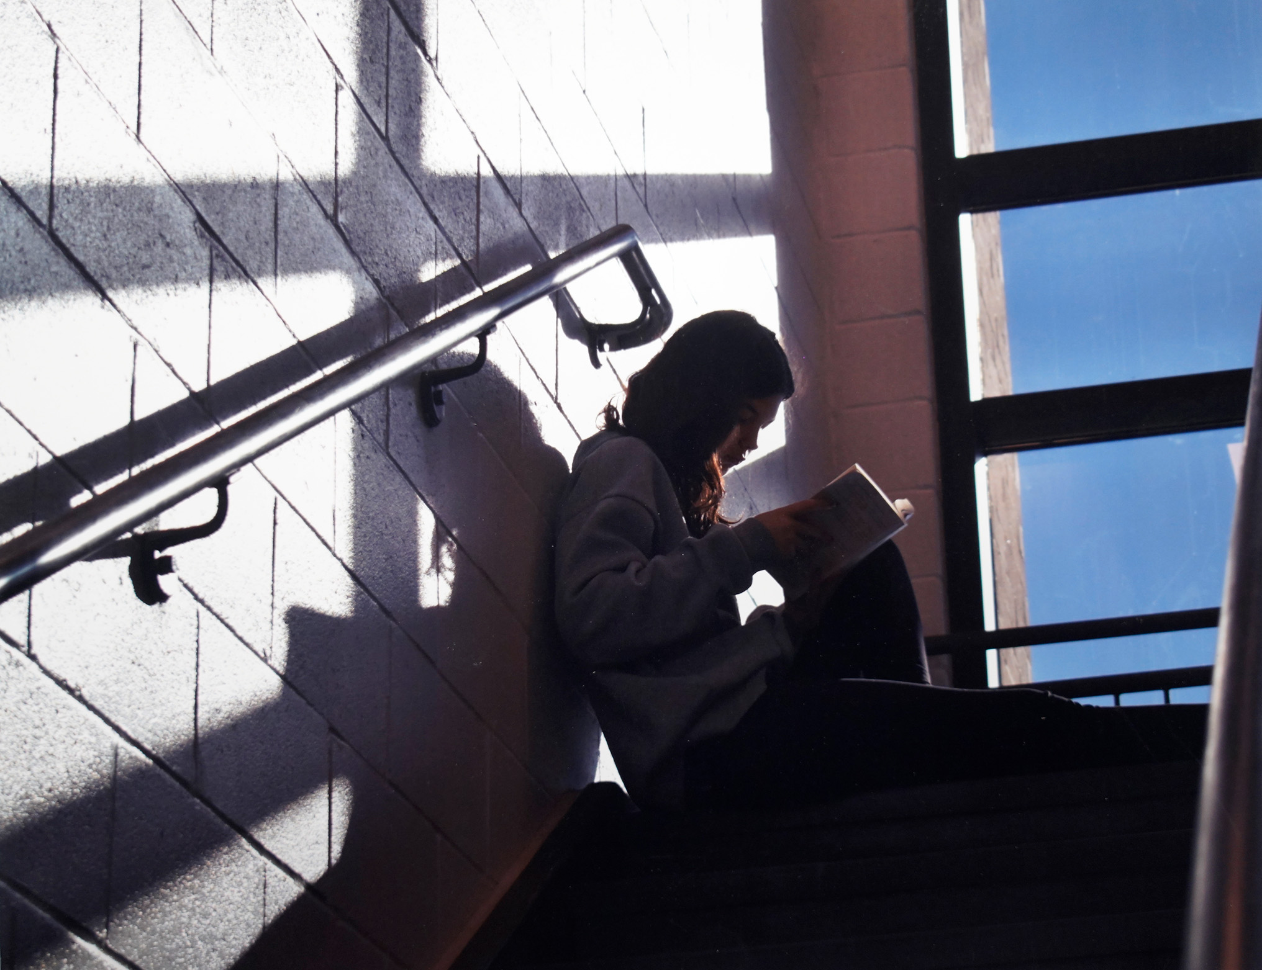
Artistic Merit
Olivia Peed
Southside Middle School
Florence School District One
Teacher: Robin Voss

Slide 61

Artistic Merit
Kailee Middleton
A.J. Lewis Greenview Elementary
Richland One School District
Teacher: Matthew Myers

